Slide 1
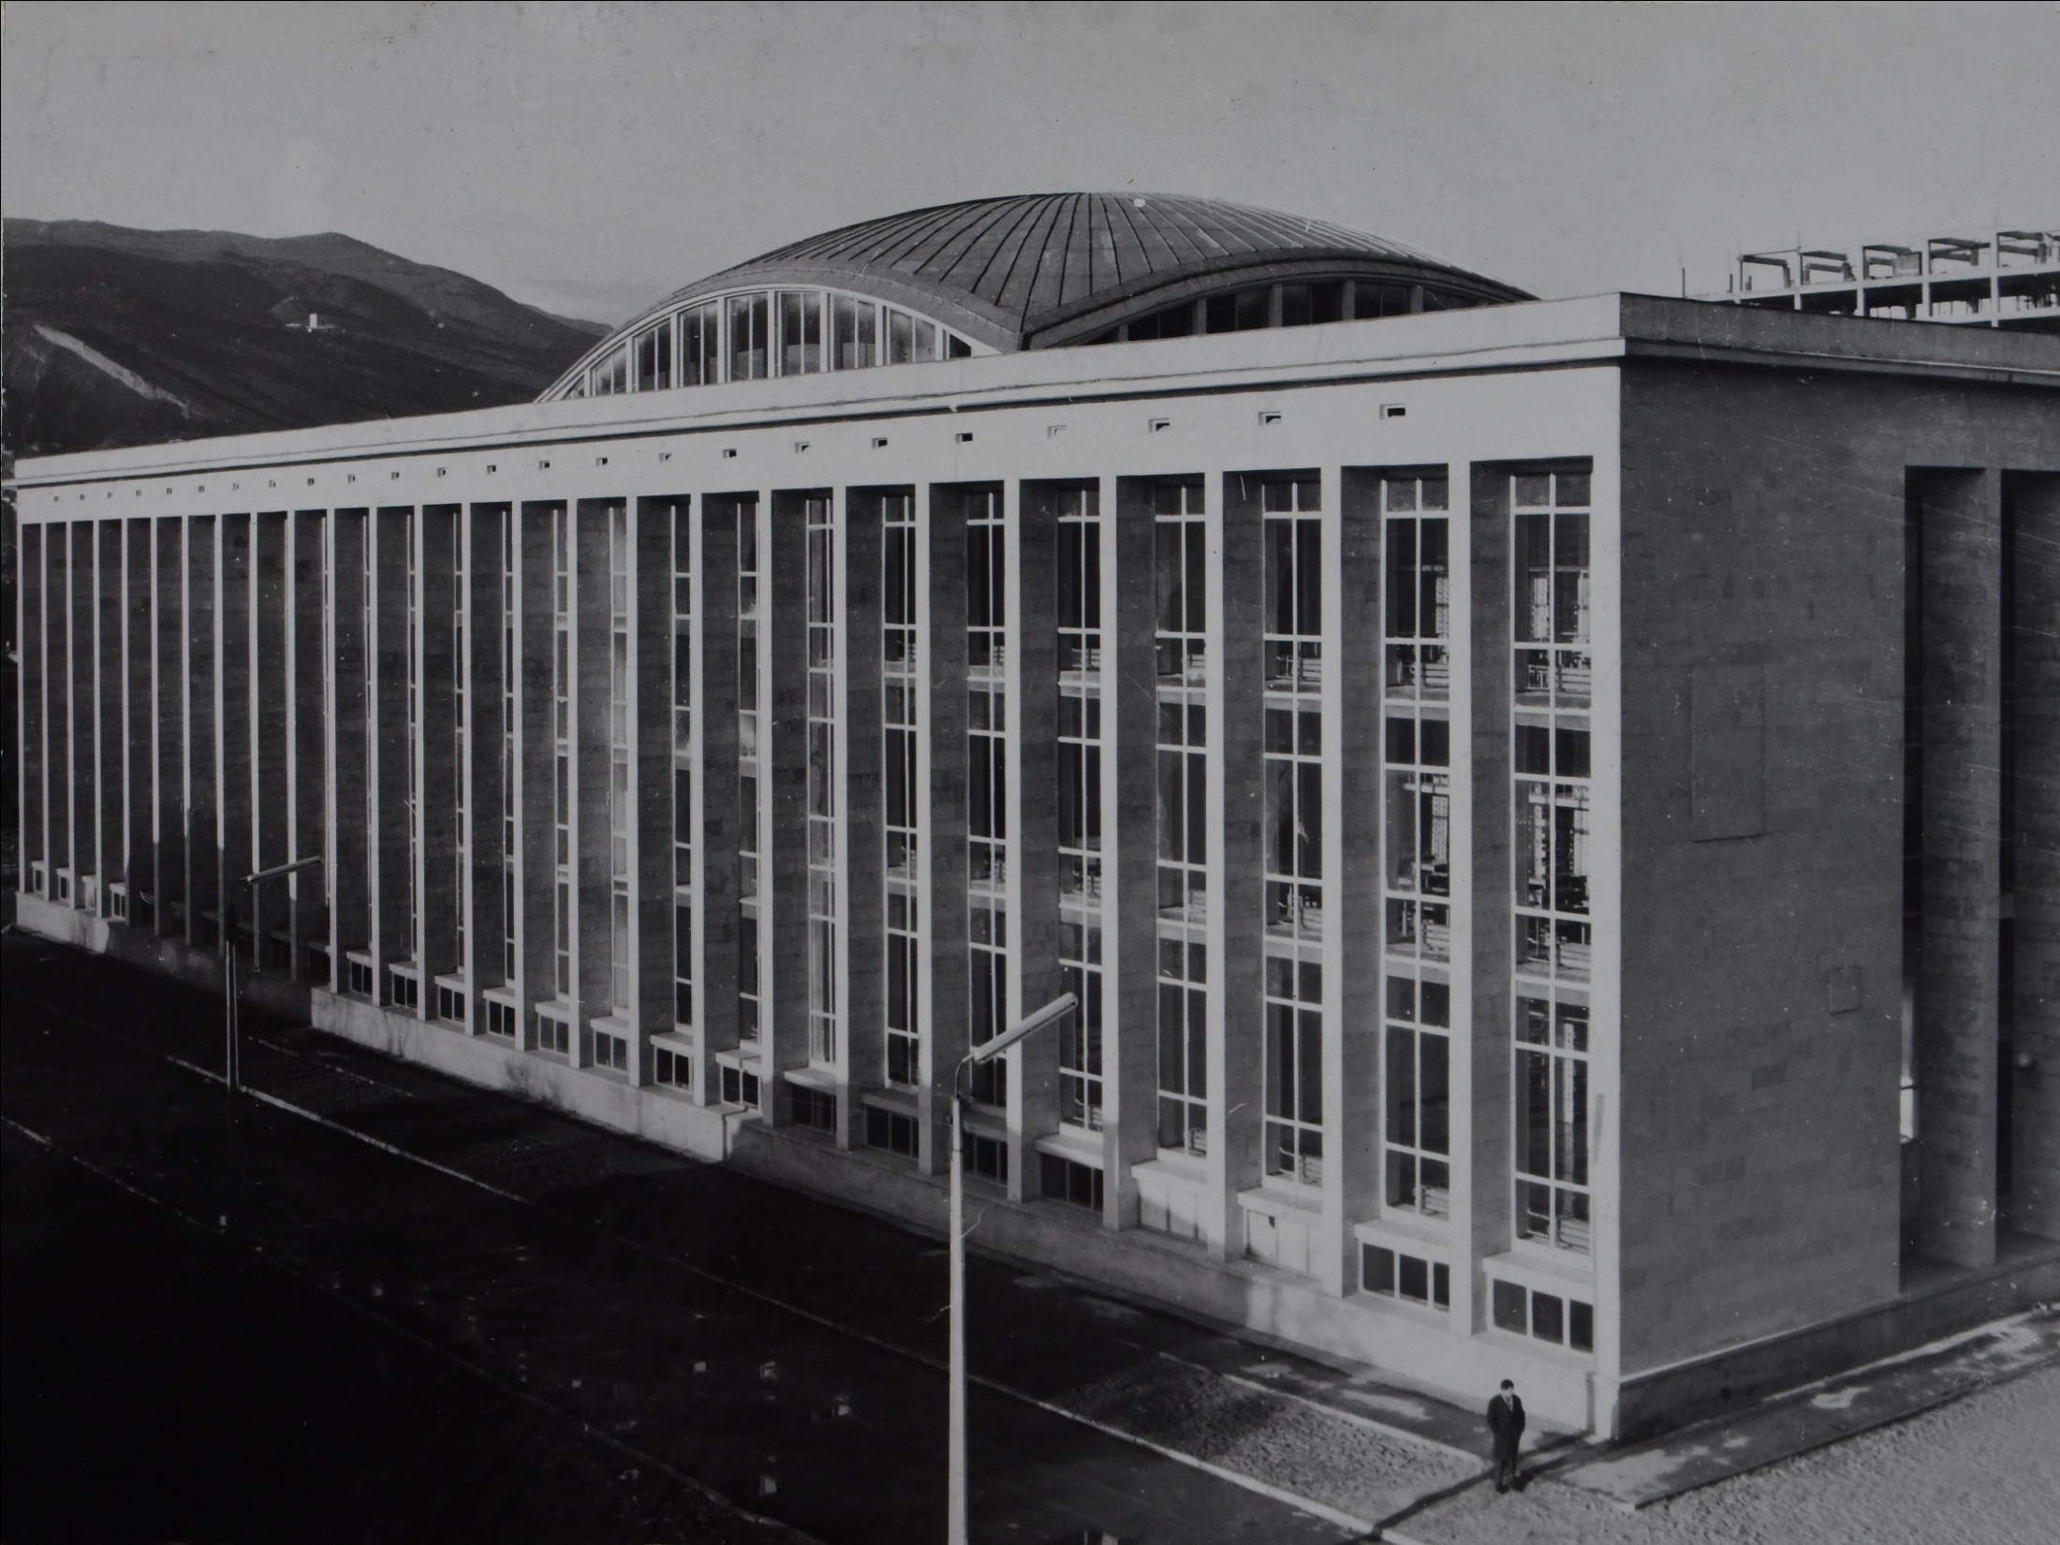
National Scientific Library of Georgia

Slide 2
Dspace-CRIS in Pictures

Slide 3
Main Page: Search & Browse

Slide 4
Filtered search

Slide 5
Communities & Collections
Community
Subcommunity

Slide 6
Import data into collection

Slide 7
Example: Linking existing data during submission

Slide 8
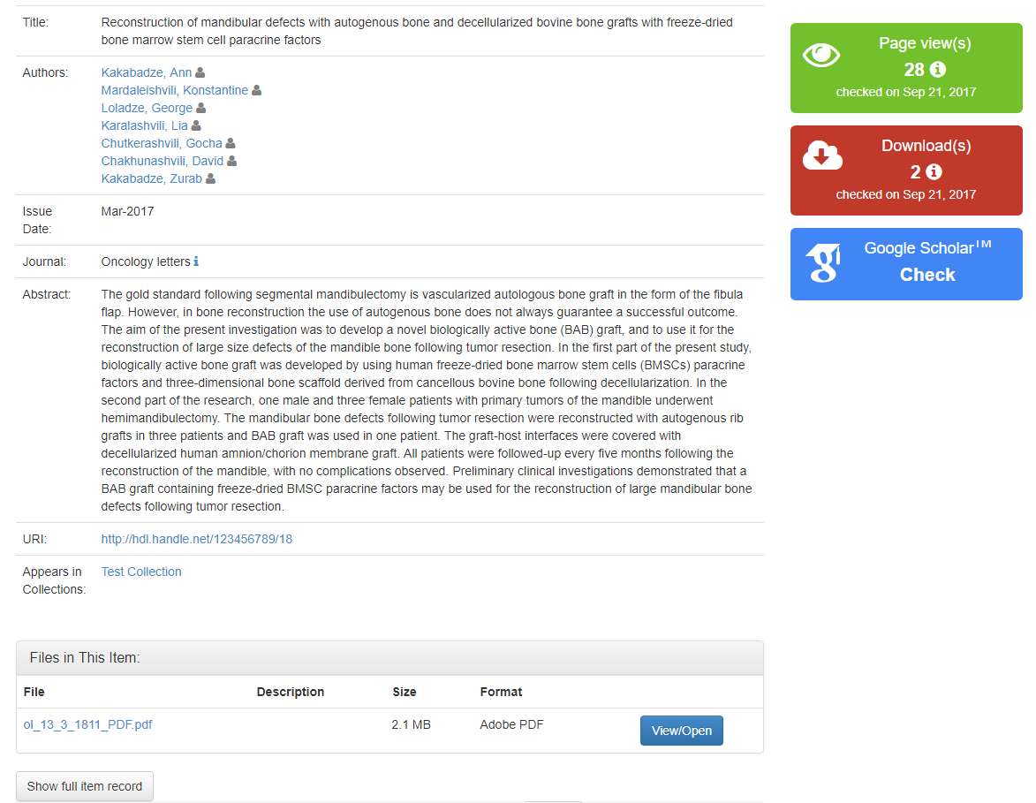
Item View

Slide 9
Customized researcher page (http://hub.hku.hk)

Slide 10
Geographical statistics (http://dspacecris.eurocris.org)

Slide 11
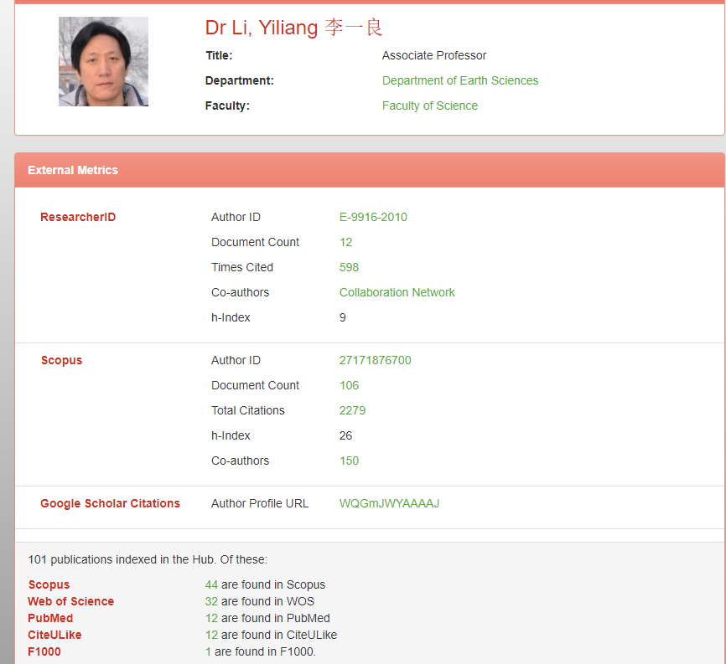
Metrics

Slide 12
Thanks for attention!

