Slide 1
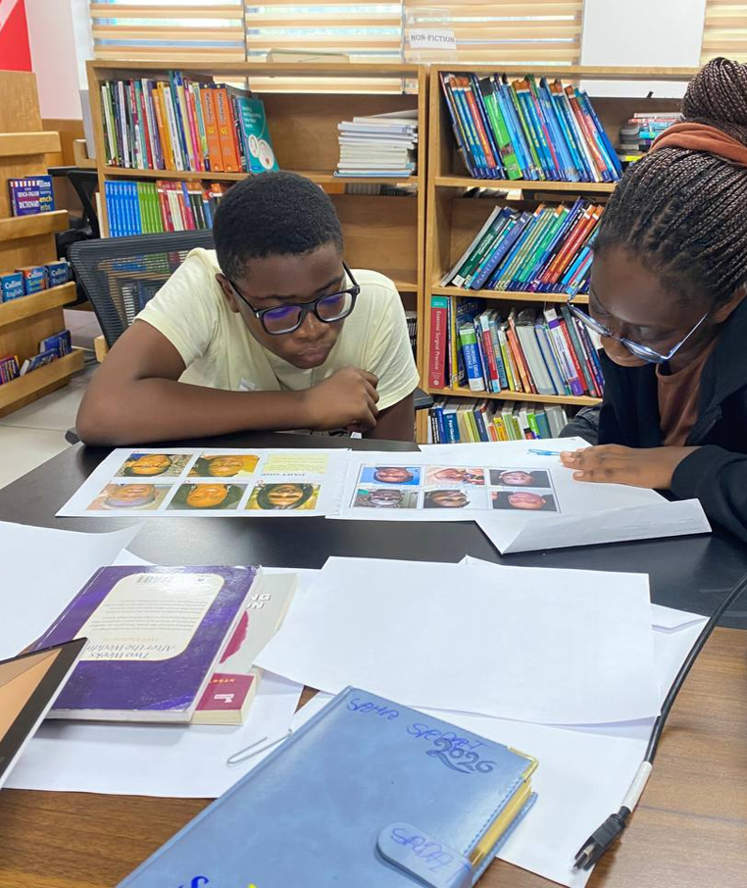


A Case Study of Public Libraries in Ghana:
Equipping Students with Critical Information Literacy Skills in the Age of AI and Misinformation
IFLA Information Literacy Section’s Satellite Meeting – ‘Information Literacy in a Disrupted Information Ecosystem: AI, Misinformation, and Trust’ –
Busan Metropolitan Library – August 8, 2026

Slide 2
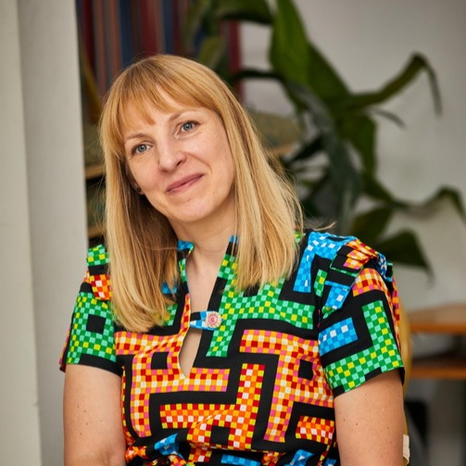

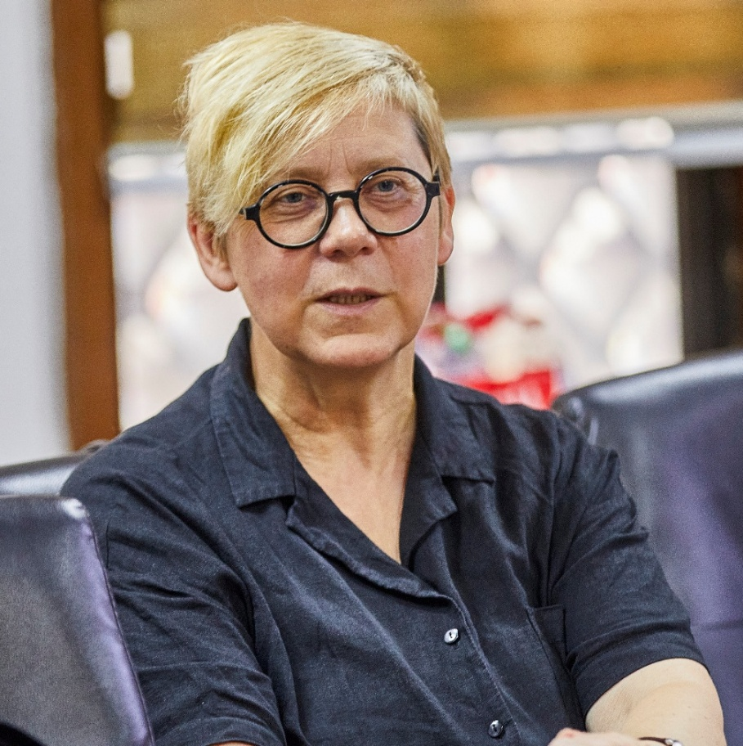
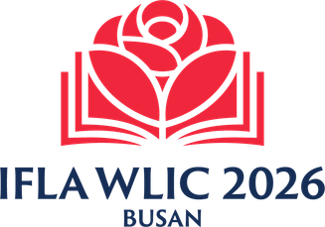
Authors
Ugnė Lipeikaitė
EIFL-PLIP Impact Manager
Santiago, Chile
Ramunė Petuchovaitė (presenter)
EIFL-PLIP Programme Manager
Vilnius, Lithuania

Slide 3
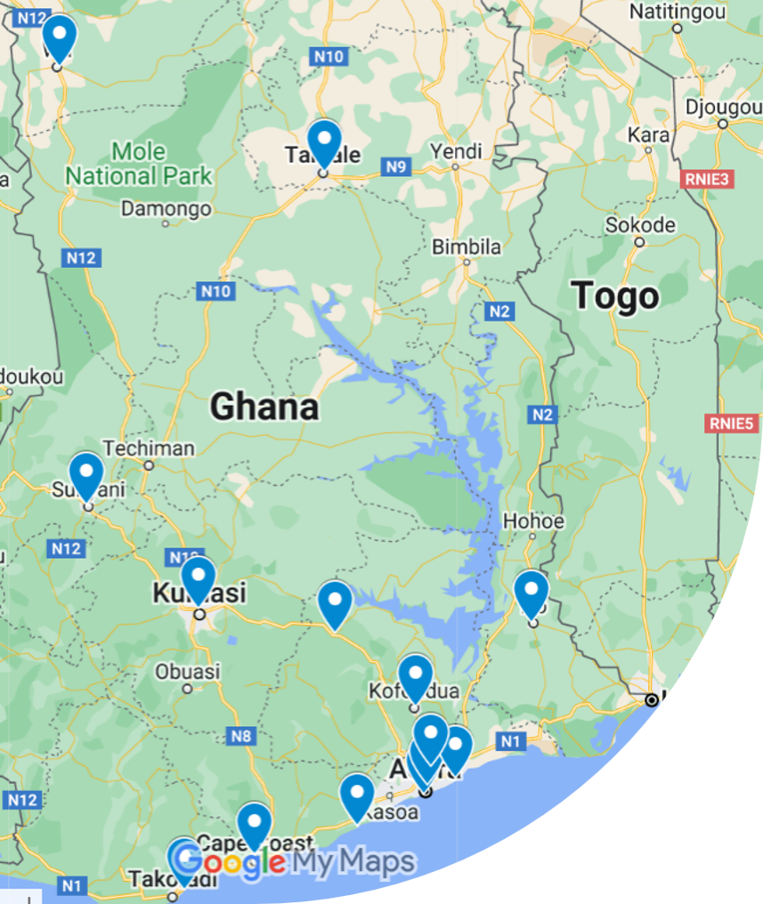
The Digital Learning @ Ghana Public Libraries project
Addressed the challenges of students' digital skills gaps, device shortages, limited network connectivity, and the lack of ICT teachers in some schools.
Aimed to expand educational opportunities for students aged 12 to 18 by advancing their digital skills and engaging them in digital learning based on free and open educational resources (OERs) through public libraries.
Engaged 15 public libraries across Ghana.
32-month project, completed in May 2026.

Slide 4


Project partners
Ghana Library Authority (GhLA) is a government institution under the Ministry of Education responsible for establishing, equipping, maintaining, and managing public libraries in Ghana.
EIFL (Electronic Information for Libraries) is a not-for-profit organization that partners with libraries to enable access to knowledge for research, education, and livelihoods in more than 50 developing and transitioning economy countries.

Slide 5
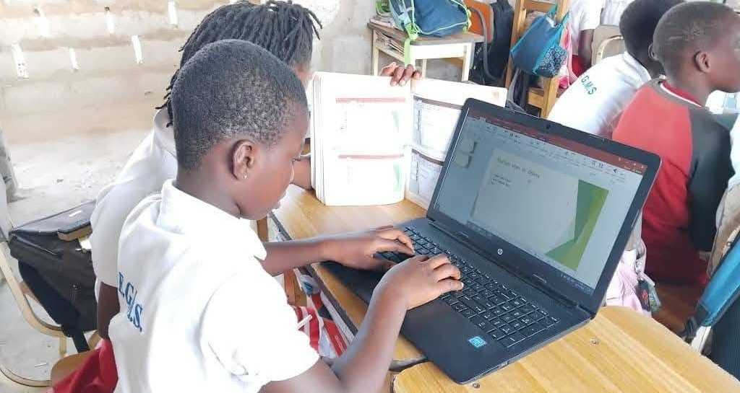
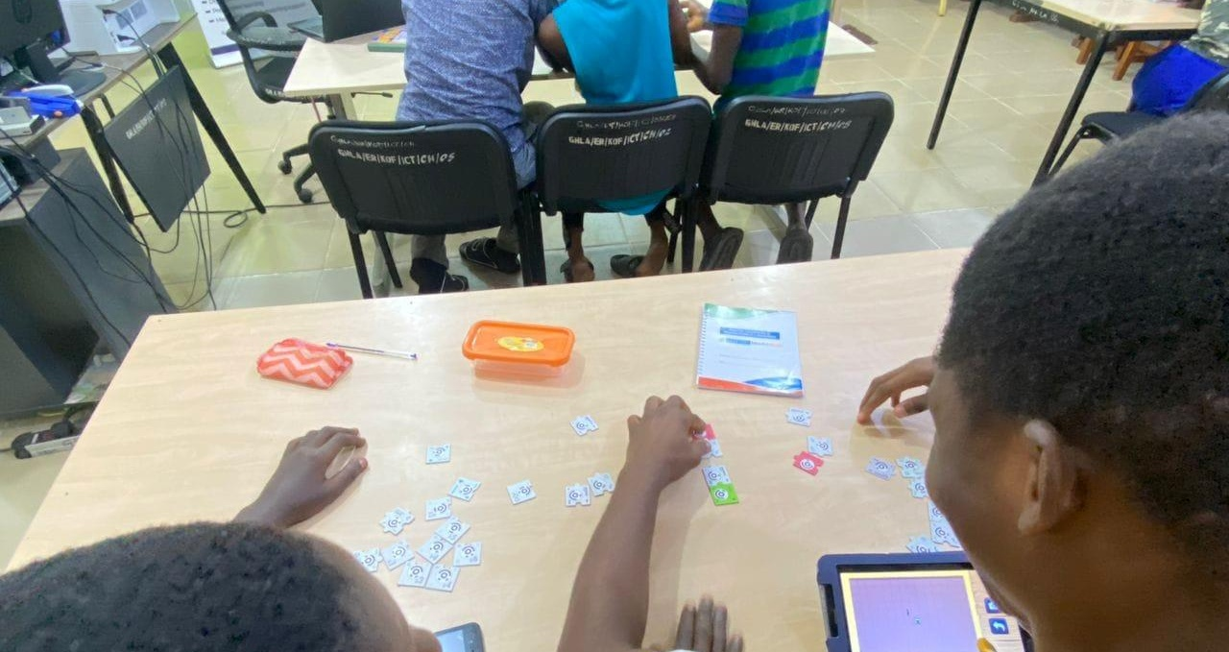
Key activities
Needs assessment informed decisions about the training curriculum and OER’s.
Training of Trainers built the capacity of 30 public library staff to become digital learning facilitators.
Outreach to schools brought fun, engaging classes on various digital subjects and some tablets to share.
Four-to-six-week-long digital learning workshops in libraries deepened and advanced students' digital and information literacy skills.

Slide 6
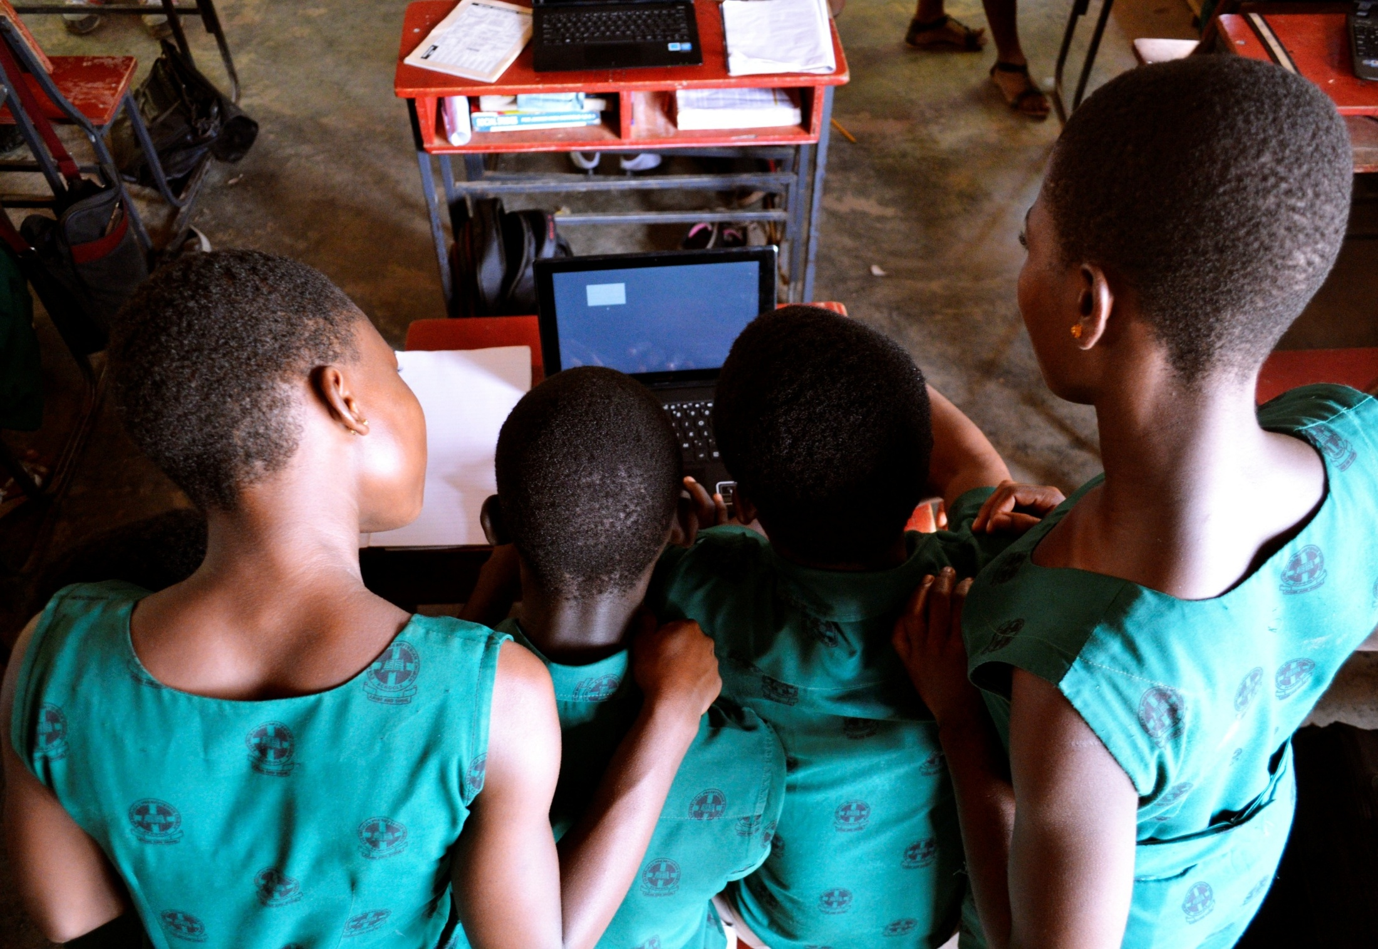
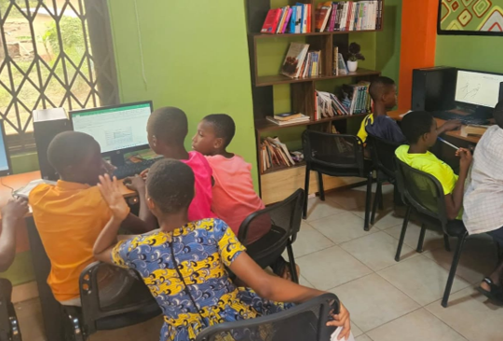
By May 2026, Ghanaian public libraries engaged more than 22,100 students
Over 19,800 students from more than 300 Junior and Senior High Schools improved their digital literacy skills through outreach visits.
Over 2,300 students attended advanced 4-6-week in-library digital learning workshops and received certificates.

Slide 7
How did we achieve this?

Slide 8
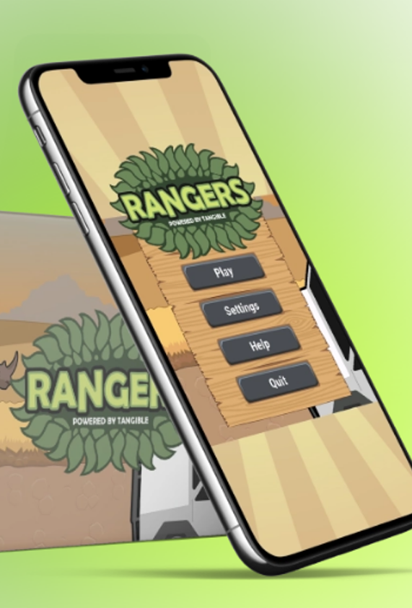
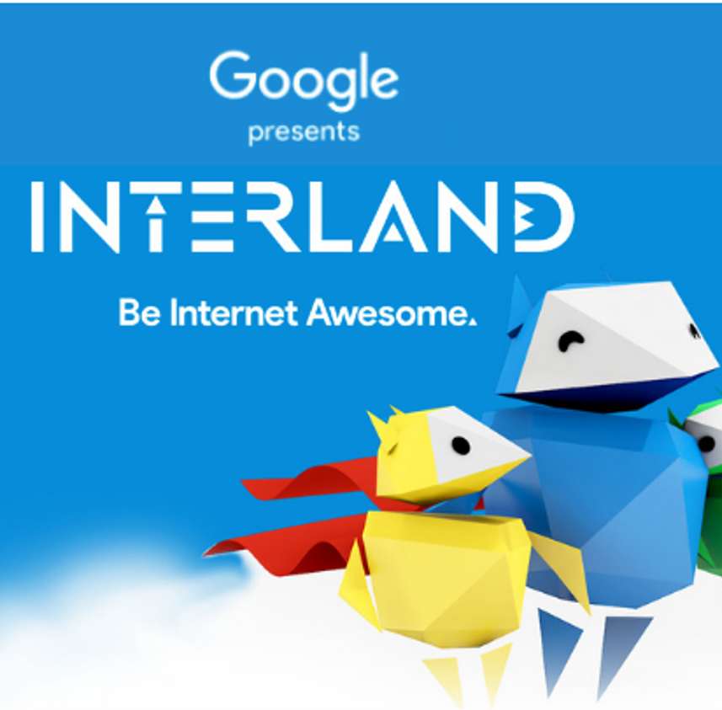

From the beginning, we have chosen a hands-on, interactive, game-based approach to teaching information literacy skills.
We selected and adapted existing open educational resources for the target audience.

Slide 9
We conducted a needs assessment study
Hands on essential ICT skills
Information literacy
Coding /Web development
Graphic design
Online safety
Digital reading
178 interviews with regional and municipal education officers, head teachers, ICT teachers, and students.
Verified the topics for the project's Training of Trainers programme for library staff and informed the selection of the OER’s for library information literacy activities.

Slide 10
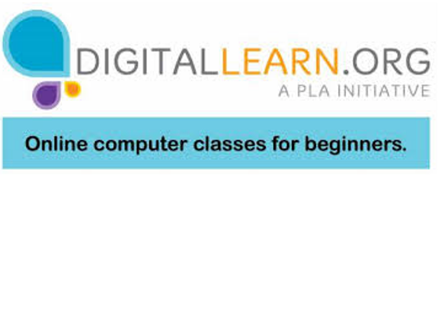
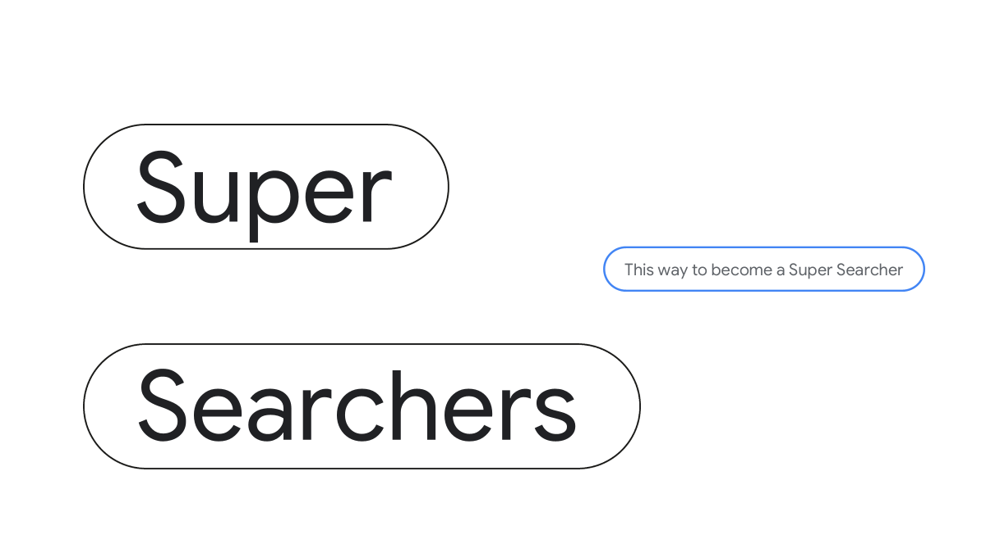
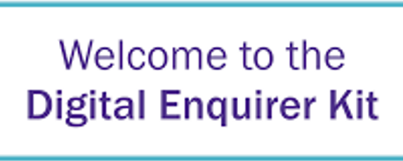

Primary resources used for library information literacy training for students
Internet Basics course on the DigitalLearn.org platform.
Super Searchers course was developed by Google specifically for library information and digital literacy training.
The Digital Enquirer Kit, a media literacy skills course developed by Tactical Tech.

Slide 11
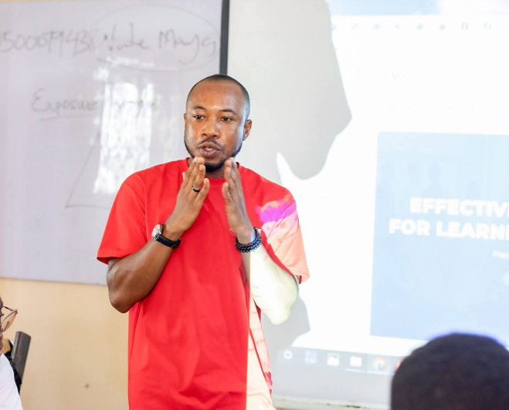

We co-created additional resources to address concerns about misinformation and AI-generated content
The offline escape-room-style game “Mission Viral”, designed to help young people understand misinformation, deepfakes, and AI-generated content.
Two facilitator guides and presentations compiled adapted by EIFL:
  Smart Use of Artificial Intelligence (AI);
  Navigating the Truth: Understanding Misinformation.

Slide 12
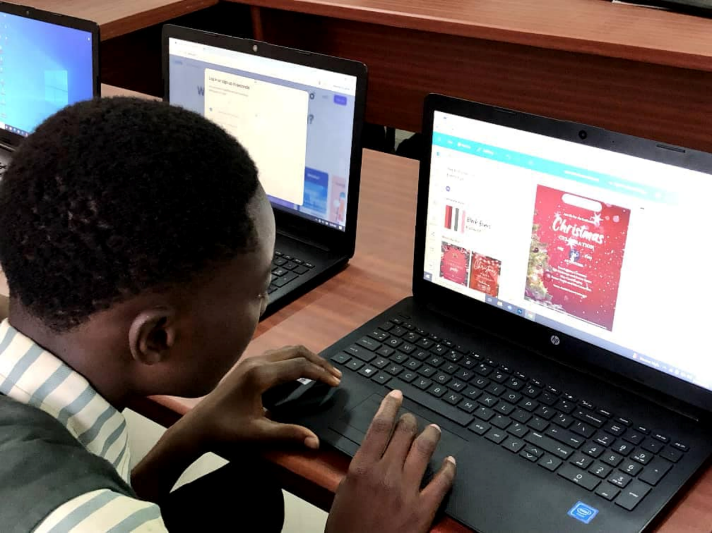
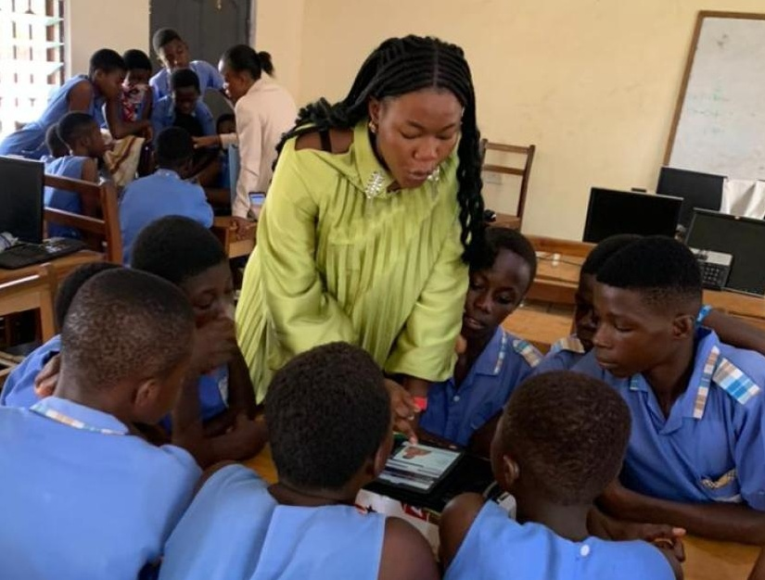
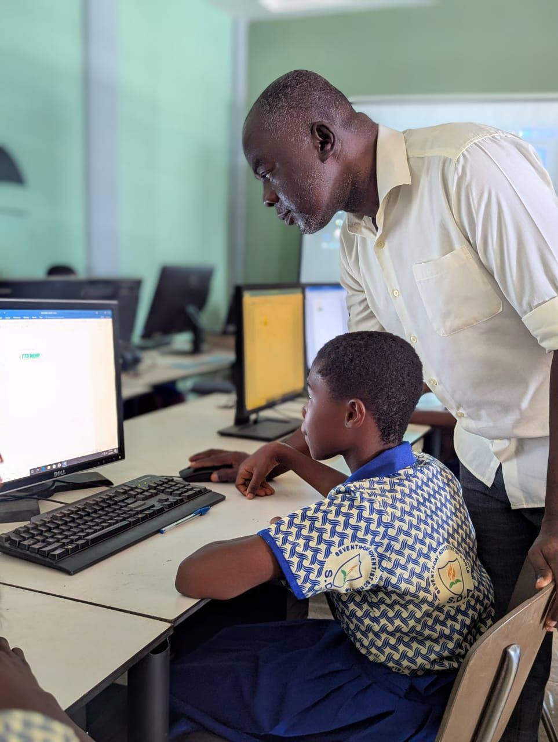
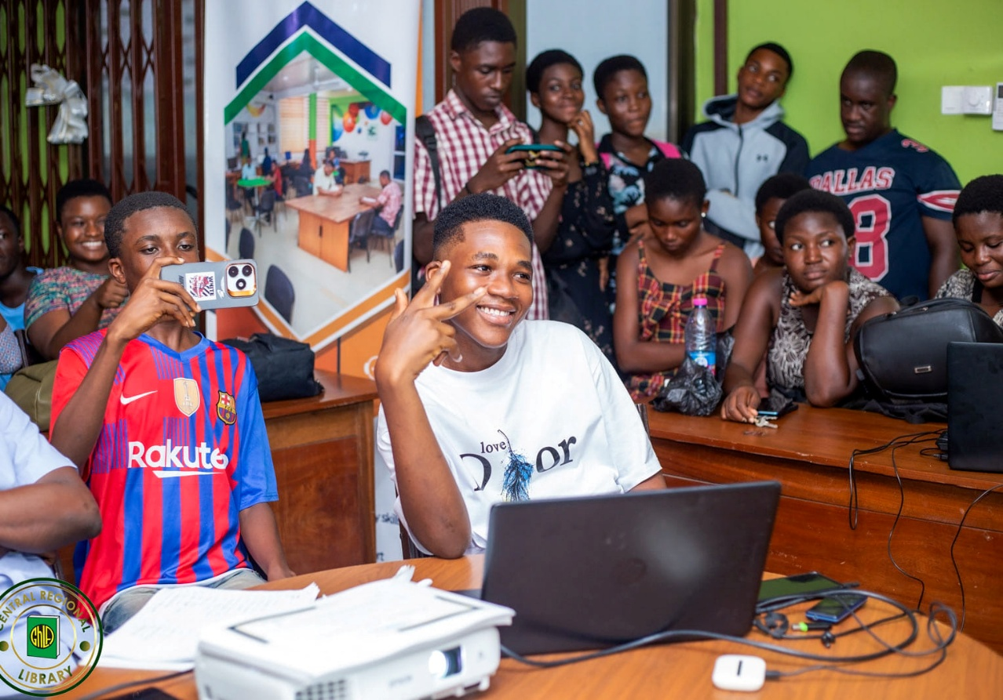
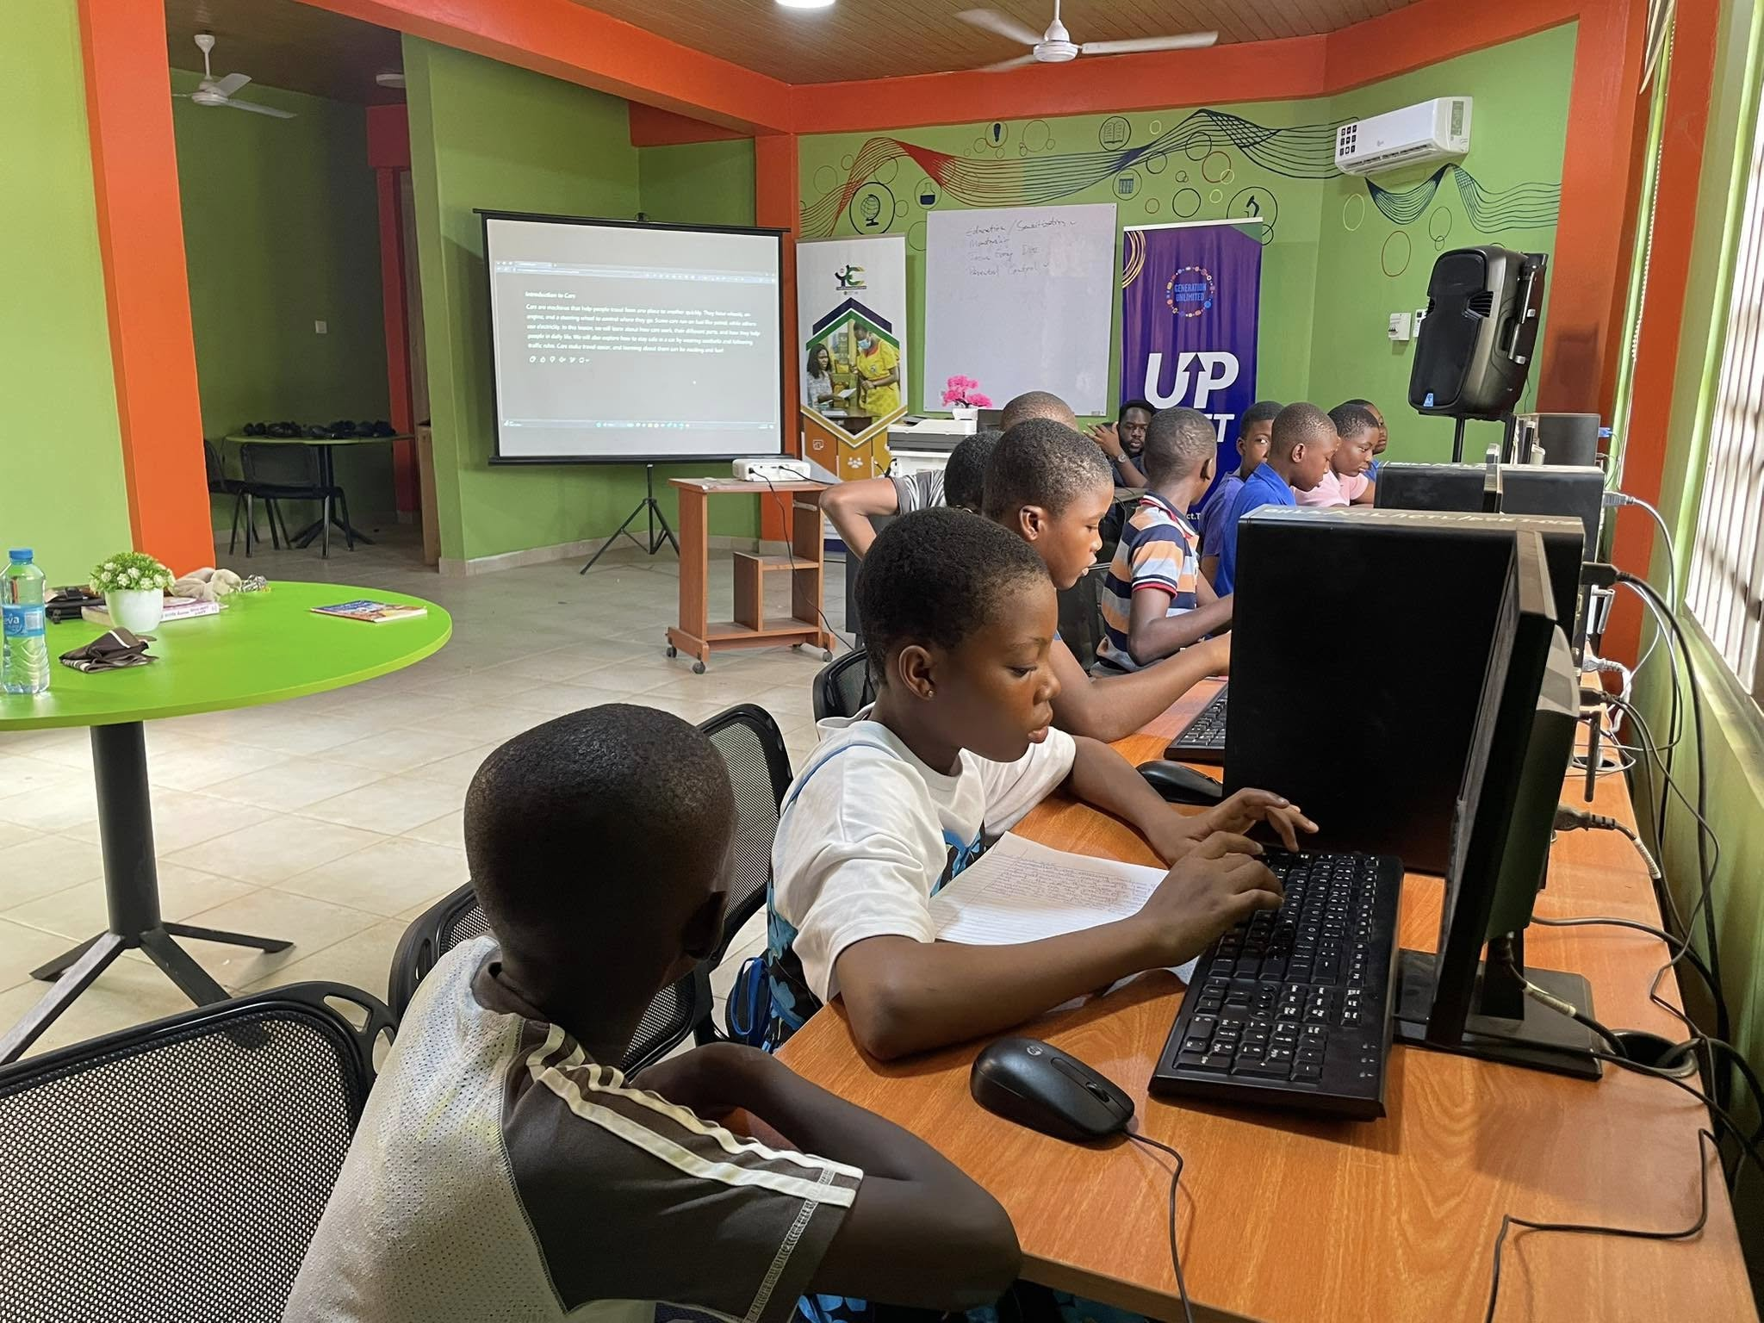
What are the outcomes and impact?

Slide 13
Outcomes
The post-training survey results (N=517) indicate a significant impact on learners' confidence and willingness to engage with technology: 96% of participants claimed increased confidence in using the internet and digital devices.
112 participants of Digital learning workshops that included Information Literacy subjects, reported improved skills in finding, evaluating, using, and sharing information online.
Teachers observed positive changes in students' engagement and motivation.

Slide 14
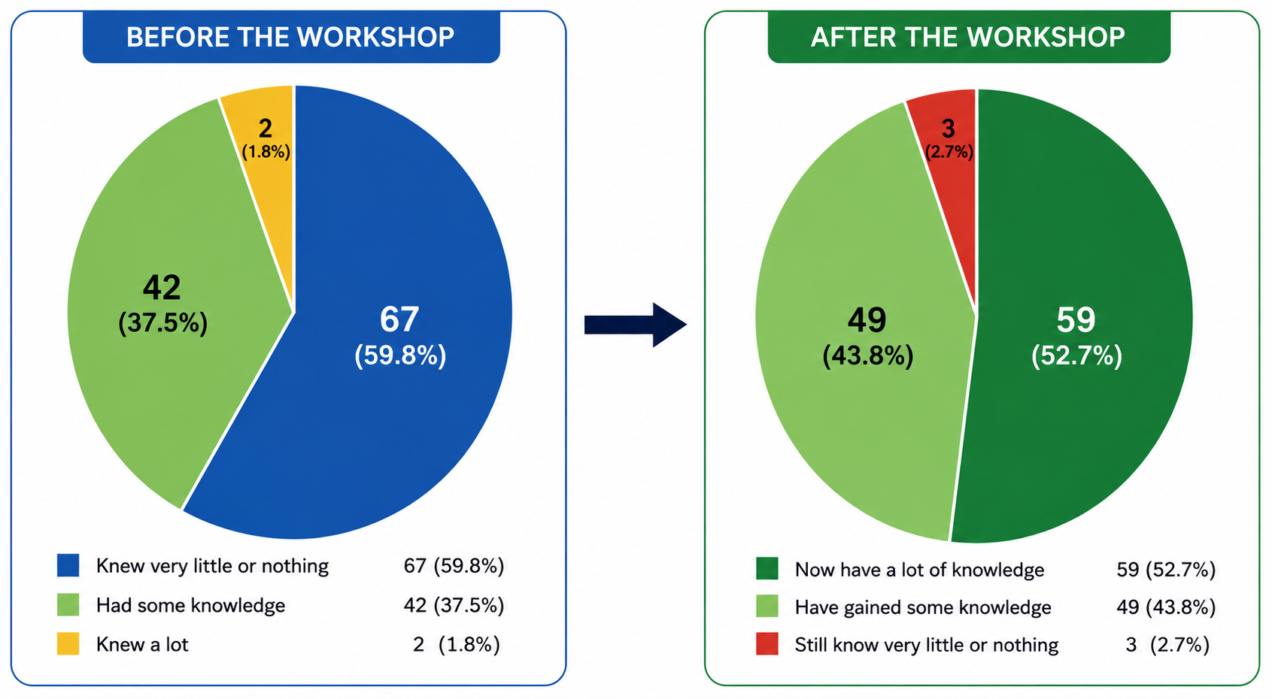
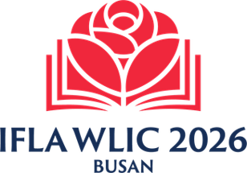
Students improved their knowledge of online searching and evaluation

Slide 15
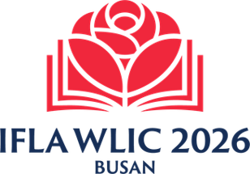
Students put their information literacy skills into practice
Student from Cape Coast Public Library, Ghana
“What I learnt at the library has helped me in many ways. For instance, I can now tell whether information is real or fake.”
Student from Central Regional Library, Ghana
“I am now using the Internet to research information for school assignments and access online educational resources.”

Slide 16
Thank you!
www.eifl.net/plip
Let’s stay connected!

Slide 17


EIFL Public Library Innovation Award: A new call is opening soon
Theme: Public Libraries Advancing Community Artificial Intelligence Literacy
Eligible: Public and community libraries from developing and transition economy countries
Deadline: Monday, October 26, 2026
Follow EIFL news: https://eifl.net/news
Each winner will receive a trophy, a $1,500 USD prize, and international publicity.

