Slide 1
OpenAthens Lite – simple, economical, secure remote access
James Edwards – Business Development Manager – Europe and Africa
Christos Skoutas – Senior Business Development Manager – Asia Pacific and Middle East

Slide 2
OpenAthens
To remove barriers to knowledge and connect people to information
By providing a robust and reliable
gateway between subscription-based
content and those who need access to it
Why?
How?
Single sign-on software that enables people to access digital content
What?
Notes:
I always like to start with the “why” – Why does OpenAthens exist?
“To remove barriers to knowledge and connect people to information”
How does OpenAthens do that?
“By providing a robust and reliable gateway between subscription-based content and those who need access to it”
What is it that we provide?
“Single Sign-On software that enables people to access digital content”

Slide 3
Our value
Happy users
Minimal admin
Peace of mind
Statistics and insights
Leave the difficult
stuff to us
Notes:
The goal is a single sign-on experience for end users that increases use of resources and removes admin for the library
Better user experience = happy users/mobile phones
The interface is so simple that it’ll reduce user queries
Tools make it easy to categorise and allocate resources
- No compromise on security, OpenAthens anonymises user identities to keep your online patrons safe
- We collect data and show you what users are engaging with, so you can make more informed purchasing decisions and prove the library’s value to your organisation
- Cloud-hosted for scalability and ease of use, OpenAthens is delivered with a Software as a Service (SaaS) approach, with 24/7 monitoring and support for piece of mind

Slide 4
Helping over 2,600 organisations enable access to hundreds of thousands of journals, databases and e-books, for over 4 million end users across the world.
4

Slide 5
Our vision
To be the world’s most user-friendly information access management experience.
5
Notes:
We are ambitious, we know the authentication landscape can be a confusing world at times, particularly if you’re an end-user attempting to navigate journal providers websites.
So our vision at OpenAthens is provide the worlds most user friendly access management experience – because library’s matter!
If we’re not all helping to deliver library content in a way that makes sense to the end-user, we quickly become irrelevant and the quality of our end-users research is compromised.
After all – SciHub is a compelling resource if you’re confused or lost at the thought of accessing your library content!

Slide 6
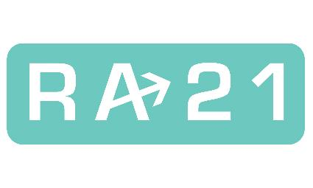
“Publishers, libraries, and consumers have all come to the understanding that authorizing access to content based on IP address no longer works in today’s distributed world.”
Source: Ra21.org
Notes:
The RA21 pilot phase completed early 2019 and the recommendations document was published in June.
The overriding conclusion was that IP should be replaced by SAML authentication in order to provide the most robust, secure and extensible solution for libraries and researchers.

Slide 7
Next generation technology
Supports user personalisation
Future proof technology
Hosted and supported
No hidden costs

Slide 8
 | Lite | Standard
OpenAthens accounts
Connection to local directory | 1 | Unlimited
Vendor connections | Up to 20* | Unlimited
Reporting | Basic | Advanced
Attribute support
Permission sets
Sub-organisations
Multi federation support
Onboarding | Service desk | Implementation Manager
Support
* Vendors from the OpenAthens catalogue. Entry level tier for 10 vendors is also available.
OpenAthens is a Jisc enterprise

Slide 9
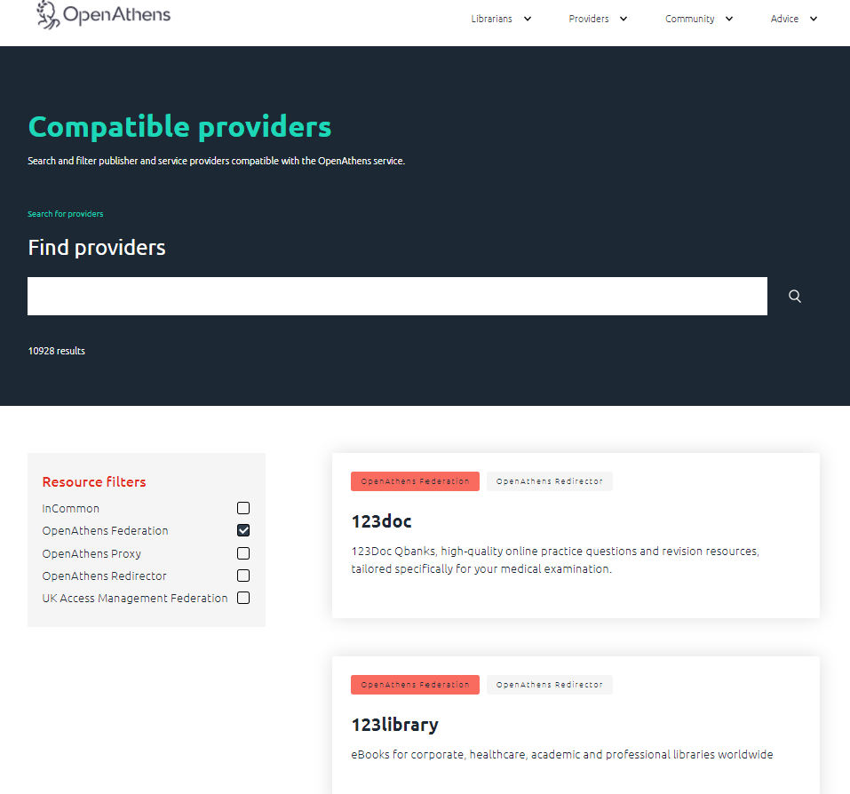
Vendor connections
What Vendors are included?
openathens.net/compatible-providers/

Slide 10
Notes:
Just some of the service providers that form the OpenAthens Federation

Slide 11
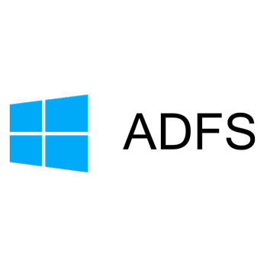
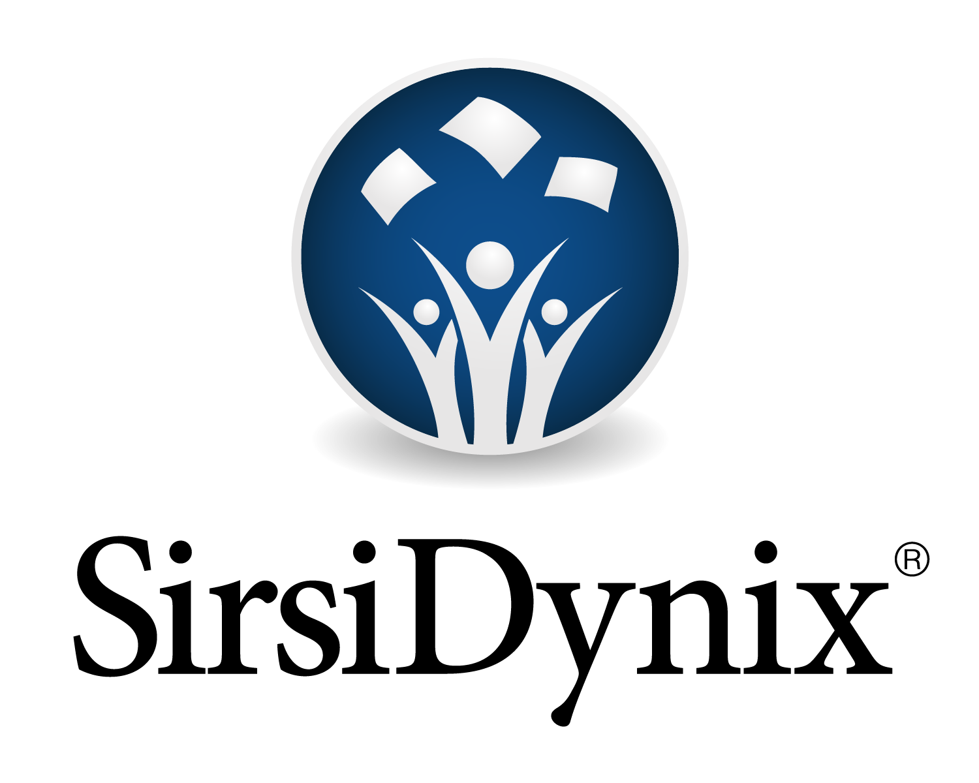
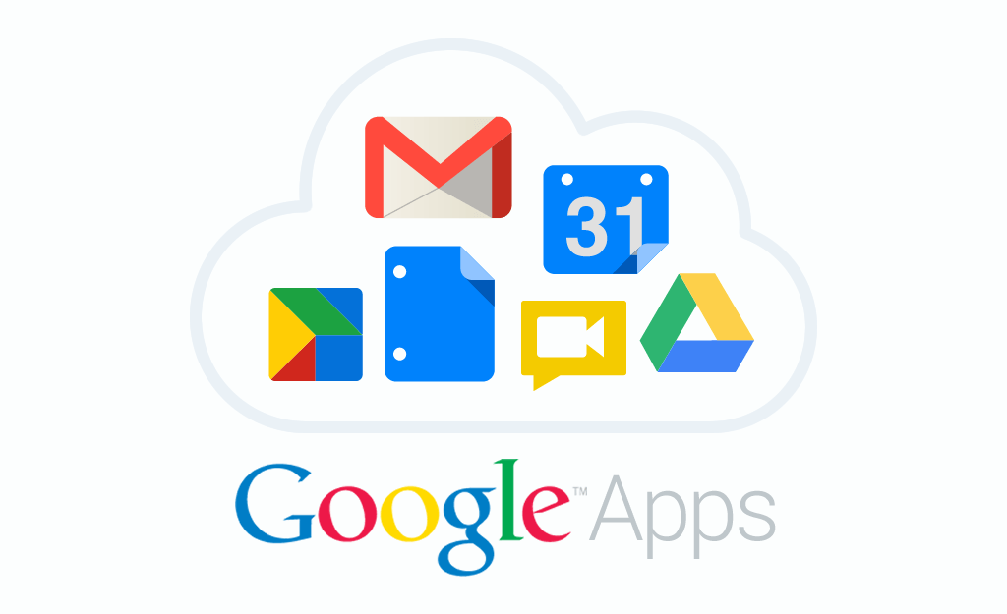
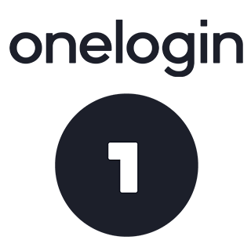
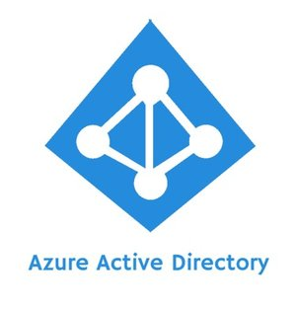
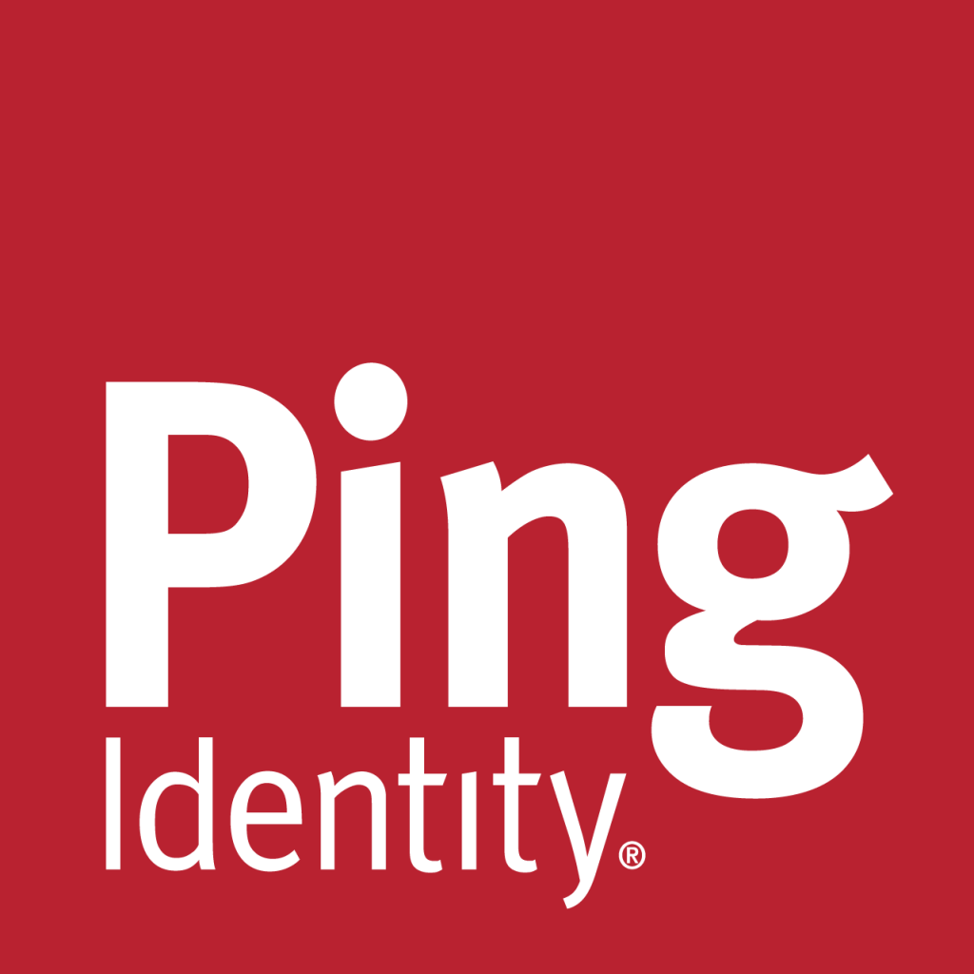
Notes:
But we’re not just limited to EBSCO and journals/databases, OpenAthens partnerships extend into all corners of the library’s online ecosystem.
From Directory services to Virtual Learning Environments (VLE) to Library Services Platforms (LSP) such as FOLIO or Alma – OpenAthens works with all of it!

Slide 12
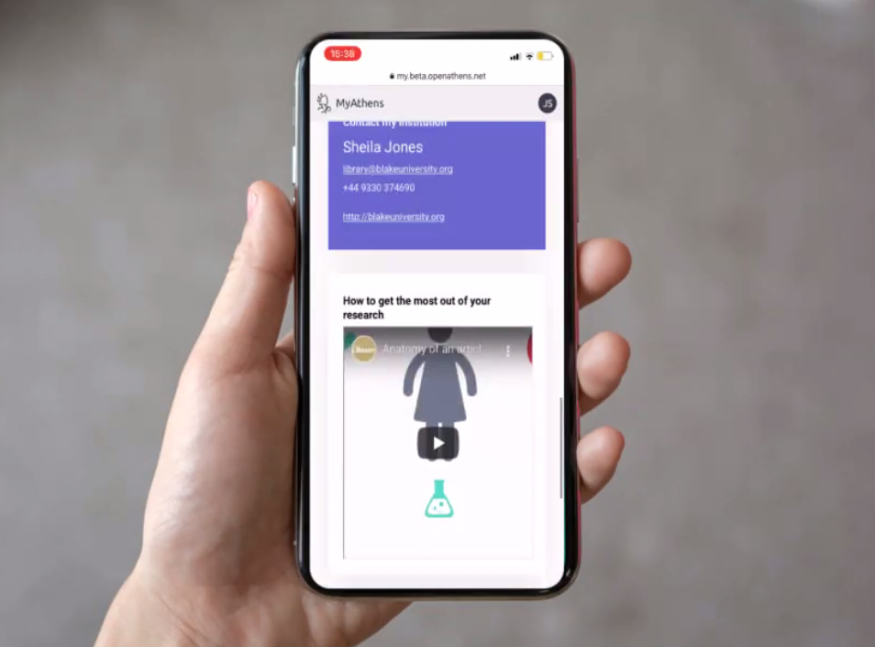
Self-registration
Invite users to create their own OpenAthens accounts
MyAthens Plus
MyAthens is a library-owned information portal that provides a mobile friendly starting point for research.
Add more connections
Add more vendors, domains and local directories*
* For organisations that have multiple campuses, sites or unique groups of users.
Add-ons
OpenAthens is a Jisc enterprise

Slide 13
MyAthens+
Enables librarians to offer a high-quality digital experience for patrons, while saving library staff time to focus on what matters most.
A single place for library patrons to see what content is available to them without needing to configure or manage any links outside of OpenAthens.
Re-designed to create a simple and intuitive user experience that is accessible for all audiences on all devices.
Notes:
Enables librarians to offer a high-quality digital experience for patrons, while saving library staff time to focus on what matters most.
A single place for library patrons to see what content is available to them without needing to configure or manage any links outside of OpenAthens.
Re-designed to create a simple and intuitive user experience that is accessible for all audiences on all devices.

Slide 14
Live demo

Slide 15
Visit
eifl.net/technology/openathens-lite
openathens.net/eifl/
Next steps:
Contact your EIFL licensing coordinator or complete the book a demo form from OpenAthens EIFL webpage.

