Slide 1
Scholarly Journals Publishing Software Adoption in Lithuania Vincas Grigas Assoc. Prof., Faculty of Communication, Vilnius University Head of Scholarly Journals, Vilnius University Press President, Association of Lithuanian Serials
OJS Best Practices and Use Cases
EIFL webinars about using Open Journal Systems
25th of March 2025
Notes:
Dear colleagues, today, I am delighted to present to you the findings of our research on "Scholarly Journals Publishing Software Adoption in Lithuania"

Slide 2
Introduction
Liegendes Mädchen mit einem Bogen Papier (verworfene Arbeit) autorius Jungnickel, Almut (Herstellung) (Fotograf) - Deutsche Fotothek, Germany - In Copyright - Educational Use Permitted.
Notes:
I have a good understanding of the practical aspects of scholarly journal publishing, given my role as the Head of Scholarly Journals at Vilnius University Press. The idea of analyzing the situation in Lithuania regarding the use of professional publishing software was intriguing, not only from a researcher's perspective but also from a practitioner's standpoint.

Slide 3
It's not who I am underneath, but what I do that defines me. – Batman in Batman Begins (2005).
Notes:
In my opinion, the use of professional publishing software in the field of publishing demonstrates a certain level of efficiency and aligns with the principles of professional scholarly communication. Therefore, I believe that this quote from Batman aptly encapsulates the essence of this research and presentation.

Slide 4
Objectives
This study investigates the adoption of professional scholarly journal publishing software in Lithuania, focusing on the trends and patterns of its use in 2020.
It underscores the limited research on proprietary software and the absence of comprehensive country-specific case studies.
Notes:
Our objectives includes adherence to best practices, efficient editorial processes, robust peer review systems, and overall professionalism in journal management.

Slide 5
Gap in Research
Tack 6003. Cerro de las Albahacas (Santo Tomé-Cazorla, Jaén, España) (3D Model) - University Institute for Research in Iberian Archeology, Spain - CC BY-NC.
Notes:
So, what gap did we have in this topic?
Tachuela or clavus caligaris (Type A), with a large head. The head tends to be conical, pointed, rather than hemispherical. The interior of the head is hollow, and from its center starts the nail itself, with a square section at the beginning and conical at the end with a bent tip. Clavus of this type have a diameter between 1.0 - 1.8 cm. The effective gap left by the bent nails, which indicates the maximum thickness of the fixed material, is 0.3 - 0.8 cm. It comes from the area of the Battle of Baecula in the Cerro de la Albahacas. The clavus caligares are the most massive assemblage of militaria at this site.

Slide 6
What is not covered?
Few studies specifically delve into the use of professional scholarly journal publishing software.
No national analysis, most studies have a broader, international focus.
Limited literature discussing other open-source software.
Lack of data that uncovers which specific software or brand is dominant within certain scholarly journal publishing ecosystems.
Notes:
Numerous aspects have been uncovered, particularly in Lithuania, despite the limited international studies delving into the use of professional scholarly journal publishing software. While existing studies focus on the international context, our literature is sparse when it comes to open-source software utilization and the dominant software brands in the Lithuanian market.

Slide 7
Method
Urkedja - Kulturparken Småland, Sweden - CC BY.
Notes:
Since there are no studies to use as examples, we had to develop and employ our own data collection and analysis methods.

Slide 8
Data Collection Challenges
Determining the precise number of active scholarly journals in Lithuania is challenging due to the absence of a recognized register.
The ISSN agency does not distinguish between scholarly journals and periodicals.
Google Scholar is not entirely reliable.
Dimensions is more reliable, but with limitations.
Not all journals in Lithuania register DOIs.
Notes:
There are several obstacles to collecting reliable data on the number of scholarly journals in Lithuania. Firstly, there is no dedicated list or registry for scholarly journals. Secondly, other sources such as Google Scholar, Dimensions, or Crossref are not entirely reliable because they do not encompass all journals for various reasons. Additionally, certain journals do not have a digital version or publish issues as a single volume without separating them into individual papers. Therefore, we aimed to gather as precise data as possible, which led us to also employ the 'de visu' method for data collection.

Slide 9
Data Collection and Analysis
Used multiple sources:
ISSN agency, Dimensions, institutional repositories, and library catalogs.
Data collection involved several steps:
Gathering titles from various sources, resulting in 515 titles.
Verifying ISSN information to identify duplicates.
Confirming the country of origin (Lithuania).
Manual examination to determine if each journal published an issue in 2020.
Narrowed down our selection to 225 active Lithuanian-based journals.
Data analysis was performed using SPSS.
Notes:
We employed several steps and sources to compile the most reliable list of active journals in 2020. Initially, we had over 500 journals, but after verification, the number was reduced to 225 active journals.
For data analysis, we utilized SPSS, conducting frequency analysis, descriptive statistics, and crosstab analysis to assess software adoption in various research fields.

Slide 10
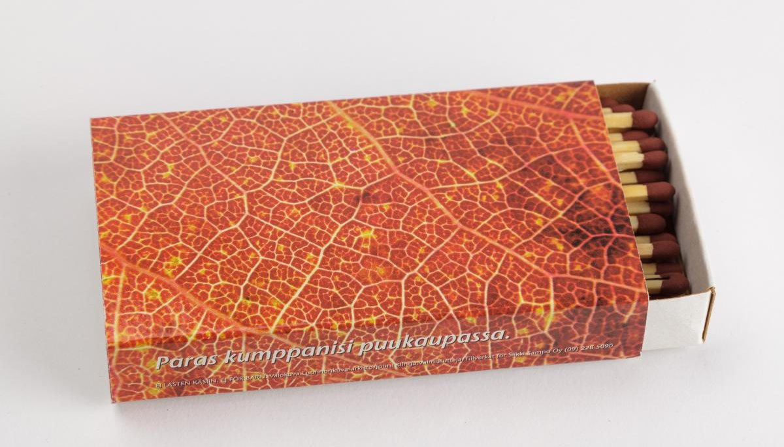
Findings
Tulitikkurasia autorius Silkki Sampo Oy, valmistuttaja: Stora Enso - 2003 - Lusto - The Finnish Forest Museum, Finland - CC BY.
Notes:
So, personally, the most interesting part for me is what we discovered.

Slide 11
Journal publication software/location
Notes:
Nearly half of the journals published in Lithuania that released an issue in 2020 used OJS3 for publishing (104, 46%). Seven journals (3%) continued to utilize the outdated OJS2 version, which was superseded by OJS3 in 2018.
It is important to note that the developer does not recommend the use of OJS2 anymore due to its outdated nature.
Overall, 111 journals (49%) in Lithuania used the OJS software. OJS remains the only open-source publishing platform utilized in Lithuania. Worldwide, there are 52 open-source publishing platforms for journals.
One-third of the journals (76, 33%) were published on institution websites, which, in most cases, are unsuitable for scholarly dissemination. Lithuanian publishers also use other proprietary publishing software, excluding institutional websites and unidentified publishing sites (other), which are utilized by 12% of journals (27 titles).
Looking at the global situation, we can see that Lithuania's frequency of OJS use (49%) is almost in line with the global trend.

Slide 12
Technology (service) for obtaining manuscripts
Notes:
OJS facilitates manuscript submission, which is utilized by 32% (72) of the journals. E-mail is the primary technology employed by 98 (44%) journals for receiving manuscripts.
For 25 (11%) journals, the manuscript submission technology remains unidentified or is in the form of a website.
Proprietary software is employed for manuscript retrieval in 30 (13%) journals.
A comparison between the frequency of software employed for publication and the technology used for submissions indicates a decrease in the use of OJS (from 111 to 72 journals) and an increase in the use of proprietary software (such as MDPI, Publimil, ScholarOne Manuscripts, and Sciendo) (from 27 to 30 journals).

Slide 13
Technology (service) for peer review
Notes:
This option is used by 31% of journals (69 journals) (Table 25). This is 18% less than the number of journals using OJS to publish.
The predominant technology for managing peer review is email and Excel, which is used by 107 journals (48%).The technology used by 21 journals (9%) for managing peer review could not be identified. Closed-source software is used by 28 journals (12%) to manage peer review. A comparison of the frequency of software used to publish with the technology used to manage peer review showed a decrease in the use of OSS (from 111 journals to 69 journals) and an increase in the use of closed source software (MDPI, EJMS, ScholarOne Manuscripts, Sciendo) (from 27 journals to 28 journals). Technology (13, 43%) and social science (28, 38%) journals used OSS for peer review management at a higher percentage than average (Table 26). Closed-source software for managing peer review was used more frequently in technology (5; 16.6%) and science (5; 31%) journals. Meanwhile, email and Excel were particularly popular among journals in agriculture (7; 70%), medicine and health (11; 31.4%), interdisciplinary (8; 72.7%) and humanities (36; 62%).

Slide 14
Technology for production management
Notes:
The OJS provides production management, which is utilized by 24% of the journals (53 titles). This number represents a 25% decrease in comparison to the number of journals that use OJS for publishing their content.
Email and Excel are the primary technologies for production management, with 115 journals (51%) employing these tools. Another 56 journals (25%) could not be categorized according to their technology preference.
Only one journal (0.4%) uses proprietary software for managing production. It is possible that proprietary solutions for production management fell under the category “Other”. When publishers were unable to identify their production management approach or were not interviewed directly, the “Other” option was selected, which was the case for most publishers surveyed.
A comparative analysis of the frequency of software used for publishing and technology used for production management revealed a 47% reduction in the usage of OJS for production management (from 111 journals to 53 journals).

Slide 15
Conclusions
Liegendes Mädchen mit einem Bogen Papier (verworfene Arbeit) autorius Jungnickel, Almut (Herstellung) (Fotograf) - Deutsche Fotothek, Germany - In Copyright - Educational Use Permitted.

Slide 16
Evolving
There are limited software options, with eight cases identified.
The ecosystem of scholarly journals in Lithuania is still evolving:
34% of Lithuanian journals publish on institutional or other websites.
Lithuanian publishers are 30% more active in using open-source software (e.g., OJS) compared to global trends in high-income countries.
This success with OJS can be attributed to EIFL‘s and The Association of Lithuanian Serials initiative in 2011, offering software and training to administrators.
Notes:
We discovered that there are eight software options employed in Lithuania. Importantly, it is worth noting that one-third of journals still use simple websites for journal publications.
Furthermore, Lithuania, when compared to high-income countries, demonstrates a strong preference for OJS, which aligns with the fact that the majority of Lithuanian journals are open-access publications.

Slide 17
Employment stages
The use of professional software in Lithuania varies across publishing stages:
66% for publication.
"Other" tools are used for 51% of production management.
OJS usage for manuscript delivery and peer review is declining due to proprietary software.
Only 24% of journals employ professional tools in all four publishing stages.
Notes:
What is surprising is that 66 percent use professional software for publication, but for all stages (submission, review, and production management), only 24 percent of journals do so. Half of the journals use other tools for production management. It's interesting to note that the use of OJS declines in the peer review stage due to the adoption of proprietary software.

Slide 18
Recommendations
There is a need to strengthen the technological base of Lithuanian scholarly journal publishers.
Given the widespread use of OJS in Lithuania there is a need focus on fully exploiting its capabilities for manuscript delivery, peer review, and production management.
Notes:
What recommendations could be made:
There is a need to strengthen the technical foundation of journal publishing in Lithuania.
Those who already use OJS for publication should consider extending its use to peer review, submissions, and production management as well.

Slide 19
Limitations
The study is based solely on quantitative data.
Phenomenographic research could be highly beneficial in providing a deeper interpretation of the data.
OJS popularity remains unclear whether this is a reflection of the software's popularity or simply a result of the lack of affordable alternatives.
Unable to determine reasons for decline in the use of OJS for manuscript delivery and peer review management.
Notes:
There are some limitations. Firstly, it consists solely of quantitative data. Qualitative data would aid in a deeper understanding of the quantitative findings.
It remains unclear what the actual reasons are for the popularity of OJS in Lithuania. Additionally, it is unclear why OJS is seldom used for manuscript delivery, peer review, or production management.

Slide 20
Acknowledgments
The research was funded by Research Council of Lithuania to implement project
"Publishing of Lithuanian scientific periodicals from the point of view of scientific communication" (2022-2024).
Methodology tuned and data collected as a team effort by:
Arūnas Gudinavičius, Tomas Petreikis, Andrius Šuminas, Agnė Zumbrickaitė, Dalia Gedminienė
Notes:
Many thanks to the Research Council of Lithuania for their financial support.
Our research represents a collective effort, and it is essential to acknowledge the contributions of the following individuals: Arūnas Gudinavičius, Tomas Petreikis, Andrius Šuminas, Agnė Zumbrickaitė, and Dalia Gedminienė.

Slide 21
Contacts
Vincas Grigas
Vilnius University, Faculty of Communication
vincas.grigas@leidykla.vu.lt
LinkedIn
ResearchGate
Notes:
If you are interested in further discussing this research or wish to explore new ideas for development, please feel free to contact me via email, LinkedIn, or ResearchGate.

