Slide 1

Presentation for use by public librarians offering misinformation training for 12–15-year-olds
Slides and notes for trainers compiled by Ugne Lipeikaite, EIFL Public Library Innovation Programme
Adapted from materials developed by the Center for an Informed Public at the University of Washington
2025
Notes:
This presentation, Navigating the Truth: Identifying and Avoiding Misinformation, Disinformation, and Malinformation, is designed for public librarians to help youth understand, identify, and avoid false, misleading, or harmful information.
This presentation has been adapted from learning resources developed by the Center for an Informed Public at the University of Washington (cip.uw.edu/misinfoday-library). We would also like to thank Yusuf Ganyana (Kenya), Jeff Nyoka (South Africa), and Prince Osei-Gyamfi (Ghana), who are actively involved in digital and information literacy training through public libraries, for reviewing this resource and providing valuable input to help localize it for African communities.
Notes For Facilitators:
The full training based on this resource takes about 90–120 minutes to complete, including practical exercises. If you have less time, you should consider shortening the content (for example, by removing some examples).

Slide 2
Navigating the Truth: Identifying and Avoiding Misinformation, Disinformation, and Malinformation
Notes:
TITLE SLIDE:
Trainers can use this slide to introduce the topic by telling the learners about the topic of today’s discussion – false, misleading, or harmful information, often referred to as misinformation, disinformation, and malinformation. We will explore the differences between these terms and, most importantly, learn how to avoid falling into a false information trap.

Slide 3
Ice-breaker: Truth or Trick?
🧼 “When you sing while bathing, you will see ghosts.”
🍊 “If you swallow orange seeds, an orange tree will grow in your stomach.”
🏞️ “Swimming in a river can cause a boy to transform into a girl.”
Notes:
Notes for Facilitators
At the beginning of a training session, we suggest conducting a fun activity that will help highlight the importance of verifying information before believing or sharing it. To set the stage, you may start with a story: A daughter asks her mother why she always cuts off the head and tail of the fish before cooking. The mother shrugs—she learned it from her own mother. Curious, the daughter asks her grandmother, who explains it was simply because her pots were too small back then. The message? Don't accept things blindly—always ask why.
Activity Name: Truth or Trick?
⏱ Duration: 10–15 minutes
Instructions:
Read each statement aloud.
Ask participants to:
Raise their hand if they think it is True
Keep their hand down if they think it is False
After each statement, clarify that this is a myth, and explain why.
“When you sing while bathing, you will see ghosts.”
❌ Myth
Explanation: Singing in the bathroom won’t make you see ghosts. This may have been told to discourage kids from being too noisy while bathing.
“If you swallow orange seeds, an orange tree will grow in your stomach.”
❌ Myth
Explanation: Seeds can’t grow in your stomach—it’s too dark and acidic. Plants need soil, sunlight, and water.
“Swimming in a river can cause a boy to transform into a girl.”
❌ Myth
Explanation: This is a false belief, likely told to scare boys from swimming in rivers to keep them safe from drowning.
Optional (if time allows):
Invite participants to share strange or funny beliefs they've heard, and talk about how we can check if they’re true before repeating them.

Slide 4
Misinformation
Misinformation is false or inaccurate information, but not necessarily intentionally false.
Notes:
Misinformation is when someone shares something that’s false or not completely correct, even if they didn’t mean to mislead anyone. It happens when someone thinks they’re sharing the truth, but the information they’re sharing isn’t accurate. The important thing to remember is that misinformation isn’t spread on purpose - people usually share it because they believe it’s true. Even though it’s not meant to harm anyone, it can still cause problems or confusion.

Slide 5

Example: eating sweets cause worms
Why might someone share this myth?
Why is this considered misinformation?
Notes:
Let’s start with a very simple example. There’s a common myth in many African countries that eating a lot of sugary foods like candies or sweets will cause worms (intestinal parasites). While poor hygiene (like eating with dirty hands or consuming contaminated food) can lead to worms, eating sweets alone does not cause worms. The real cause is exposure to parasites through unclean food, water, or environments — not sugar itself.
Note for Facilitators:
Talk to your learners about these questions:
Why might someone share this myth?
Possible answer: Adults might share this myth because they want to protect children. Since worms are common in places with dirty food or water, they use this story to warn kids. It’s easier to say "sweets cause worms" than to explain all the real reasons.
Why is this considered misinformation?
Possible answer: It’s misinformation because sweets don't cause worms. Worms come from germs in dirty food, water, or from not washing hands. Saying sweets cause worms can confuse people and make them forget the real ways to stay healthy.

Slide 6
Disinformation
False or misleading information that is deliberately shared for a reason.
Often partly true but layered with distortions or exaggerations.
Notes:
Disinformation is when false or misleading information is shared on purpose, usually to achieve something like making money, gaining power, or hurting someone's reputation. It might have a bit of truth in it, but it’s usually twisted or exaggerated to make it look different from what really happened. Disinformation in politics or business may be part of a larger plan or campaign. It involves spreading multiple pieces of false information in an attempt to influence the way large number of people think or act to someone‘s advantage.

Slide 7
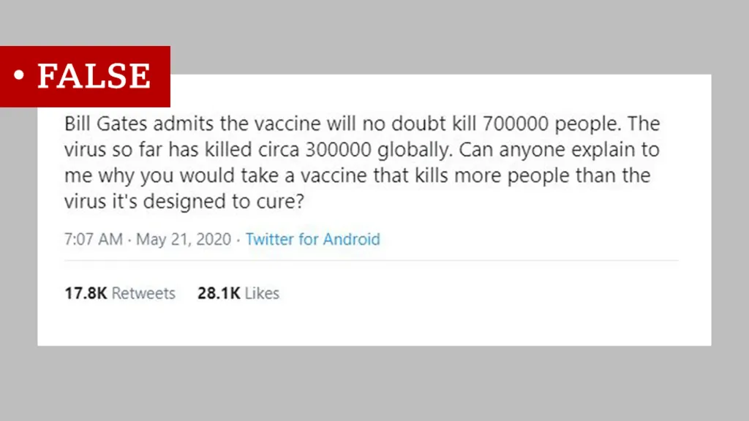
Example: COVID-19 vaccines kill people
Why would someone create this kind of false information?
Why is this considered disinformation?
Source: https://www.bbc.com/news/53525002
Notes:
During the COVID-19 pandemic, a lot of false information was shared in some African countries. People were told that the COVID-19 vaccines were unsafe and could even kill people. This false information spread quickly on social media, WhatsApp, and other online platforms. It caused a lot of fear and made people lose trust in the vaccine, so many people didn’t want to get vaccinated.
Note for Facilitators:
Talk to your learners about these questions:
Why would someone create this kind of false information?
Possible answer: People might spread false information about vaccines to make others distrust the government or health experts, push their own political ideas, or get attention on social media. Some may even do it to make money by promoting other products. The goal is often to confuse, scare, or control people’s opinions.
Why is this considered disinformation?
Possible answer: This false information was shared on purpose to change how people felt about vaccines. It was spread by social media influencers, conspiracy theorists, and sometimes even political figures who wanted to cause confusion. The goal was to mislead people, not to help or educate them.

Slide 8
MAlinformation
Real information used in a harmful way. The information is true, but it's shared to hurt someone's reputation or cause trouble.
Notes:
Malinformation is true information that is shared with the intention of causing harm, distress, or damage to someone or something. It involves taking real facts or content and using them in a misleading or harmful way, often by sharing them out of context or with malicious intent.

Slide 9
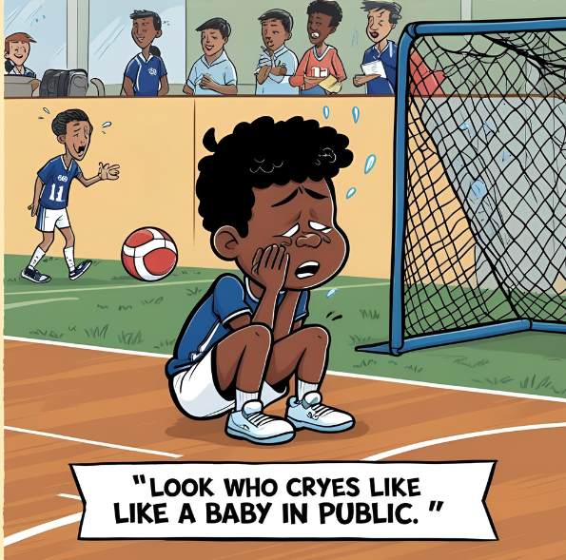
Example: SHARING EMBARRASING PHOTOS
Why would someone create this kind of false information?
Why is this considered malinformation?
Notes:
For example, a real photo could be taken during a school event of a boy crying after losing a sports competition. Later, another student shares the photo in a WhatsApp group with the caption, “Look who cries like a baby in public!” Even though the photo is real and not edited, it is used to shame and embarrass the boy.
Note for Facilitators:
Talk to your learners about these questions:
Why would someone share this kind of information in a harmful way?
Possible answer: The student may have shared it to bully or embarrass the classmate, to get attention or laughs from others, or to hurt the boy’s feelings on purpose. Sometimes people use real moments to shame others or make them look weak, especially on social media.
Why is this considered malinformation?
Possible answer: Because the photo is real, but it was shared in a harmful way to embarrass someone. The goal wasn’t to inform or help others—it was to shame and hurt. That makes it malinformation.

Slide 10
🧠 Easy to remember:
Misinformation: Wrong info shared by accident.
Disinformation: Wrong info shared on purpose to trick people.
Malinformation: True info used to harm someone.
Notes:
To sum it up, Misinformation is wrong info shared by accident. Disinformation is wrong info shared on purpose to trick people. Malinformation is true info used to harm someone. In the next slides, we will look into some examples, which will help you spot these concepts in real life situations.

Slide 11

Fabricated Content
Content that is 100% false and meant to deceive or do harm.
Example: fake MTN Uganda promotion, offering free data and other prizes.
Notes:
First, let’s talk about fabricated content—information that is completely made up.
For example, this graphic claiming to be from MTN Uganda was shared on a Facebook page with over 21,000 followers. It says, “Send Money to your Boyfriend and Receive Free Airtime and a Car with MTN MoMo.” Similar posts offering free airtime have been widely circulating in Uganda. This promotion was completely made up. Later, MTN Uganda officially stated that it was a fake promotion and encouraged customers not to believe it and not to participate.
Source: https://africacheck.org/fact-checks/meta-programme-fact-checks/no-mtn-promotion-asking-you-send-money-free-airtime-or-car

Slide 12
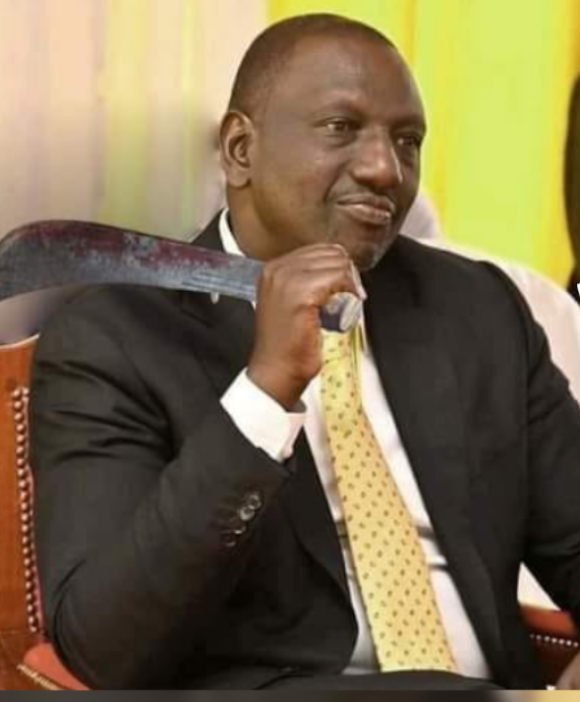
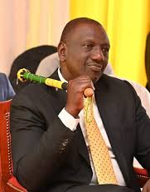
Manipulated Content
Genuine information or imagery that has been distorted.
Example: Altered Image of Kenyan Deputy President Holding a Machete
ALTERED
ORIGINAL
Notes:
Sometimes, content isn’t made up but is manipulated, meaning real information or pictures are changed to look different.
In 2022, altered image of Kenyan deputy president holding a machete over his right shoulder circulated on social media. This image was shared widely, especially during politically charged periods, leading to various interpretations and concerns among the public. However, Fact Checkers discovered that the image was digitally altered. The original photograph, published in 2021, showed Deputy President Ruto holding a decorated baton, not a machete. The machete was added using photo-editing software to misrepresent the context and potentially incite fear or political tension.
Source: https://africacheck.org/fact-checks/meta-programme-fact-checks/kenyan-deputy-president-holding-machete-no-image-altered

Slide 13
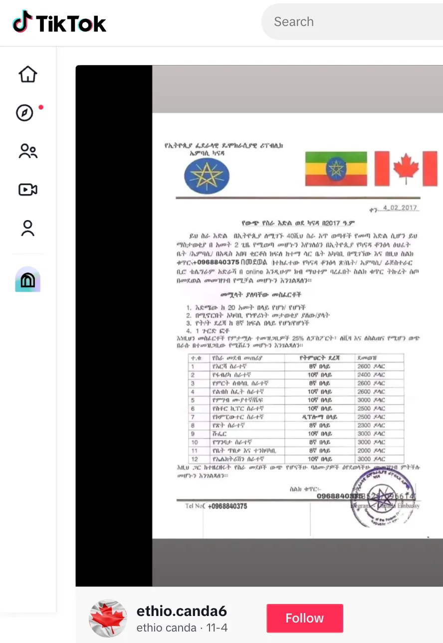
Imposter Content
The creator is pretending to be someone else—often a well-known individual or organization—in order to deceive others.
Example: Fake job offers pretending to be from official government-linked agencies.
Notes:
Let’s look at another way false content is spread, called imposter content. This happens when someone pretends to be someone else or uses a well-known company or organization's logo to trick people, spread lies, or ask for money, pretending to be that person or organization.
For example, in the slide, you see a screenshot from a TikTok video claiming to offer job opportunities in Canada for young Ethiopians. The letter is made to look formal, has flags of both countries, and claims to be connected to the Canadian Embassy, but it is totally fake.
Source: https://pesacheck.org/hoax-this-letter-announcing-job-opportunities-in-canada-is-fake-2467c8a30d39

Slide 14
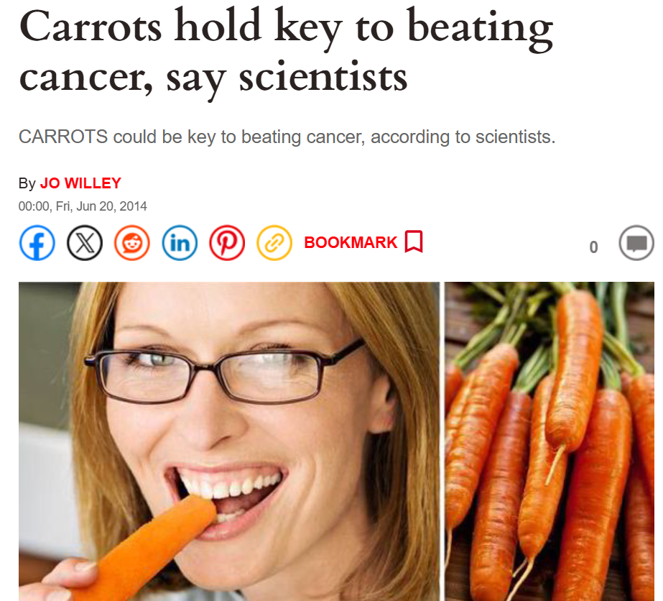
Misleading Content
Misleading information presented as a fact.
Example: Articles and YouTube videos stating that eating carrots or drinking carrot juice cures cancer.
Notes:
Misleading content happens when someone shares information — like a comment or opinion — and presents it as if it’s a proven fact.
For example, some online articles and YouTube channels, even those with many followers, post videos claiming that eating carrots or drinking carrot juice can cure cancer. To appear credible, these sources often mention 'experts' such as doctors or scientists - but deliberately don't give real, links to institutions or references to specific research or data. They also take partly true information (like the fact that carrots are healthy) and exaggerate it into a false claim (that carrots can cure cancer). This kind of misleading content is dangerous because it can lead people to make poor health decisions, such as avoiding or delaying real medical treatment they need.
Source: https://www.express.co.uk/news/uk/483656/Carrots-hold-key-to-beating-cancer-say-scientists

Slide 15
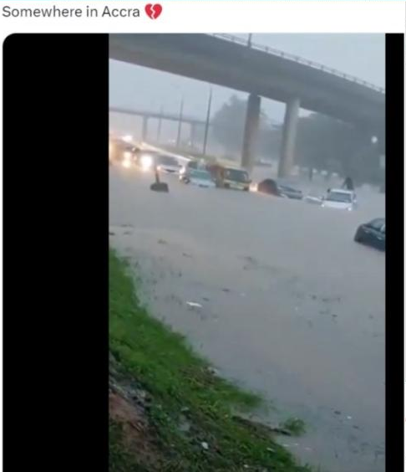
False Context
Genuine content is shared with false contextual information.
Example: this image showing heavy flooding is real, but it was from a flood in Lagos, Nigeria, not Accra, Ghana.
Notes:
False context is when something real is shared in a way that makes people believe something that’s not true.
For example, in July 2024, during heavy rains in Ghana, a video was shared online showing flooded streets and cars underwater. People thought it happened in Accra. But the video was actually taken from a flood in Lagos, Nigeria, not Ghana. So, even though the video was real, the way it was used was misleading.
Notes for facilitators:
If you feel your learners are losing focus, you can pause and have a short discussion. Give them time to think and talk by asking questions like: "Why do you think someone would spread such a message?" or "How would you know it is false context?"

Slide 16
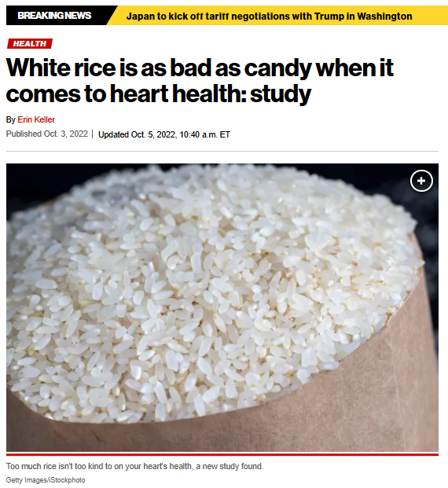
FALSE CONNECTIONS - CLICKBait
When headlines, visuals or captions do not support the content.
Example: A headline claimed that eating white rice is as bad as candy, but the actual study didn’t say that—it only warned about eating too many unhealthy, processed grains.
Notes:
False Connections happen when a picture, video, or headline says one thing, but the actual story or post says something else.
Media outlets and online content creators often use attention-grabbing headlines that don’t accurately reflect the actual content, to increase the readability of their articles or posts. This is called clickbait, because it attracts clicks like bait used to catch fish. Clickbait headlines make people believe something exciting or shocking is happening, even if it isn‘t, and leave it up to the reader to find out. For content creators, more viewers and more reads means potentially more revenue.
For example, a headline claims that a study proves eating white rice is as bad as eating candy. But if you read the full article, you’ll find that the study never said that. In reality, the researcher said that eating too many unhealthy, processed grains can be like eating too much sugar or oil — they didn’t mention white rice or candy at all!
Source: https://nypost.com/2022/10/03/white-rice-is-just-as-bad-for-your-heart-as-candy-study-suggests

Slide 17
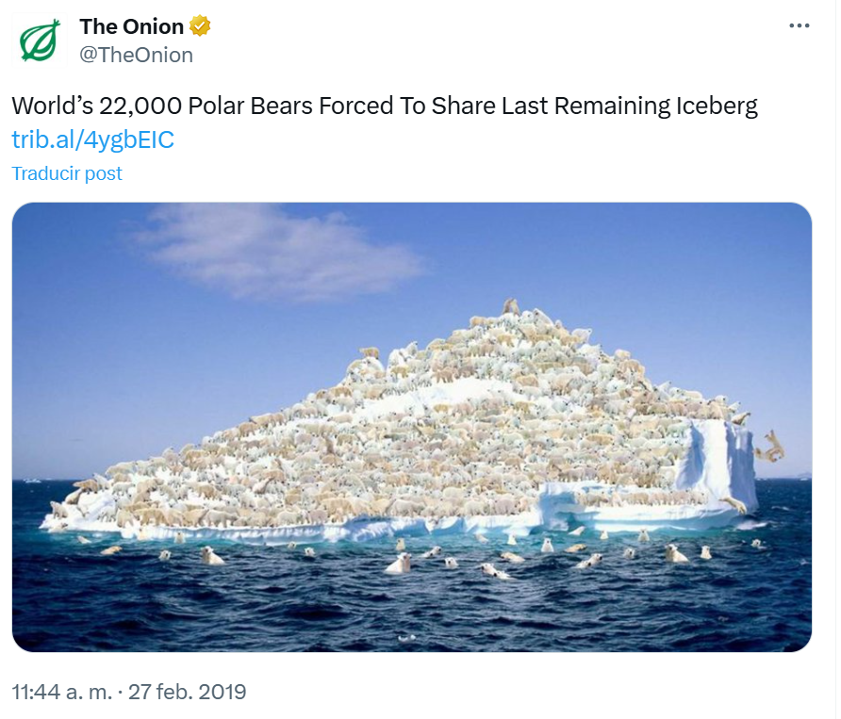
Satire and Parody
Humorous but false stories passed off as true.
If you know The Onion makes fake news for fun, you’ll get the joke—but others might believe it’s real, especially if it’s shared without context.
Notes:
Satire and Parody is when funny or made-up stories are presented as real. They're meant to make people laugh, not to hurt anyone. But sometimes people can still mistakenly believe them and help spread it as misinformation.
For example, this post about all remaining white bears having to share one last iceberg. If you know that The Onion is a website that makes silly fake news on purpose, you’ll get the joke. But someone who doesn’t know that might think the story is real—especially if it's shared by a friend or seen online without any explanation.
Source: https://x.com/TheOnion/status/1100768545871482882

Slide 18
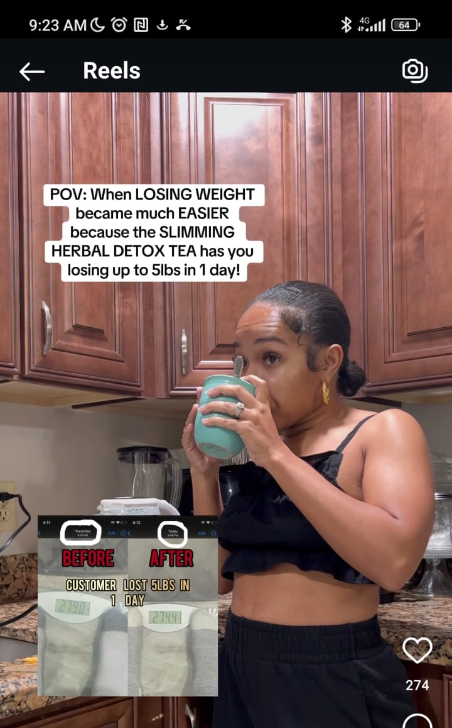
Sponsored Content
It looks like regular advice, but its main purpose is to promote a specific brand/product.
Example: Your favorite influencer might share tips that seem helpful, but it's actually a paid promotion for a specific brand.
Notes:
Sponsored content is when a company pays someone—such as an influencer or a website—to share advice or information that appears to be regular content but is actually intended to promote a specific product or brand.
For example, many influencers in West Africa post videos promoting herbal detox teas for weight loss. In the image you see a woman who shares how drinking a particular tea supposedly results in rapid weight loss, claiming it can help someone lose up to 5 pounds in a single day. It’s important to recognize that such influencers are not sharing genuine information, but advertising a product—often without scientific evidence to support its effectiveness or safety.
Source: https://www.instagram.com/_fevermagic_?igsh=dmkxZ2l1M3k5ZTIw

Slide 19

PROPAGANDA
Content used to manage attitudes, values and knowledge.
Example: This fictional poster uses emotional messages like heroism and patriotism to support a military operation and promote values that align with a political agenda.
Notes:
Propaganda is when information is shared in a way that strongly tries to influence what people think, believe, or feel — often to support a specific idea, group, or cause. It may leave out important facts or show only one side of the story.
For example, look at this poster — it's fictional, but it could be considered propaganda because it presents a one-sided message aimed at shaping public attitudes, in this case, to support a military operation. It uses emotional appeals, like heroism, patriotism, and protecting children, to persuade rather than to inform. The goal is to sway public opinion and promote certain values, such as loyalty and unity, in line with a particular agenda.

Slide 20
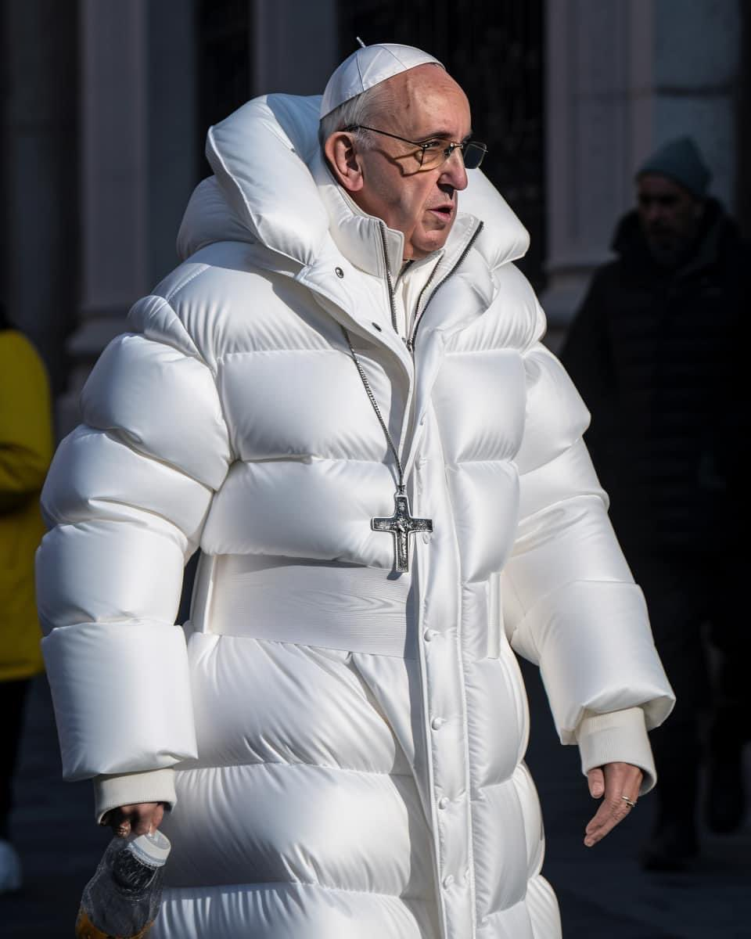
AI-POWERED MISINFORMATION
Artificial intelligence used to create or change information, like photos or videos, to make it look real, even though it's fake.
Example: AI-generated fake images of Pope Francis wearing a puffer coat.
Notes:
AI-powered misinformation happens when computers, using artificial intelligence, create or change information—like photos or videos—to make it look real, even though it's fake. These tricks can confuse people, spread lies, or make us believe things that aren’t true.
Fake videos and images generated by artificial intelligence have spread so quickly that they’re now nearly as common as those manipulated by traditional editing tools like Photoshop.
For example, one of the first AI-generated fake images was of Pope Francis wearing a puffer coat, which went viral on the internet in 2023.
Source: https://www.nbcnews.com/tech/pope-francis-ai-generated-images-fool-internet-rcna76838

Slide 21
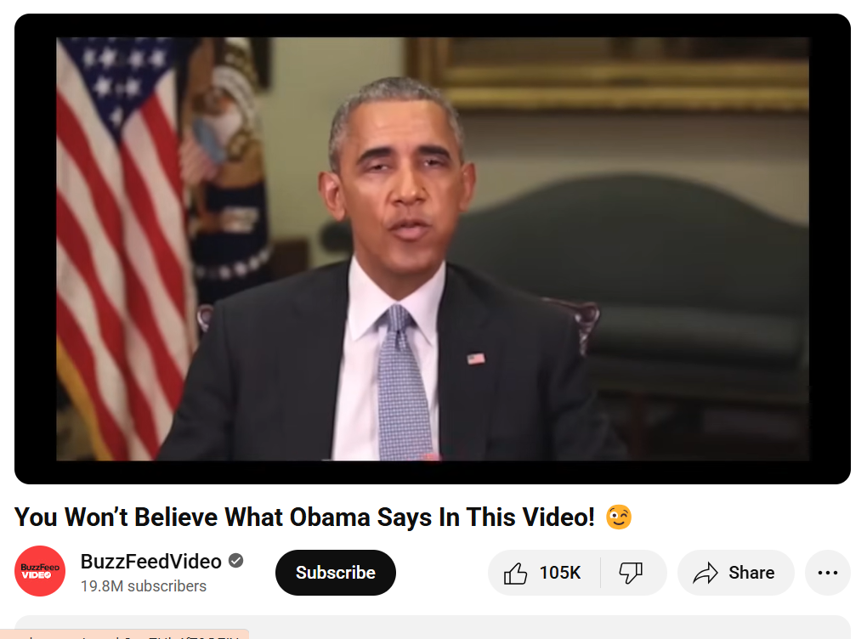
DEEP FAKE
A deepfake is a type of video or audio that uses artificial intelligence to make it look or sound like someone is saying or doing something they never actually did.
Example: AI-generated fake video
Notes:
A deepfake is a type of video or audio that uses artificial intelligence to make it look or sound like someone is saying or doing something they never actually did. It’s like a fake video where a person’s face or voice is replaced with someone else’s, making it seem real even though it is not. These fake videos can be spread for various reasons, such as financial scams, political manipulation, celebrity impersonations, and more.
For example, a few years ago, a video titled "You Won't Believe What Obama Says In This Video!" went viral, demonstrating the possibilities of deepfake technology. At first glance, it appears to show former President Barack Obama delivering a serious message, but midway through, it is revealed that the voice is actually another person’s (comedian Jordan Peele), and the visuals have been digitally manipulated to match the fake speech. This project was designed to highlight the potential dangers of deepfakes—realistic fake videos generated using artificial intelligence—and to raise awareness about how easily misinformation can be spread through convincing fabrications.
Source: https://www.youtube.com/watch?v=cQ54GDm1eL0
Notes for facilitators:
If you have the technical resources available during the training session (such as an internet connection, projector, computer, and loudspeakers), you can also play an explanatory video that shows how the Obama deepfake video was created: https://www.youtube.com/watch?v=AmUC4m6w1wo.

Slide 22
HOW misinformation spreads
Word of Mouth: Especially through Family Members and Friends
Traditional Media: Radio, TV
Social Media Platforms: Facebook, WhatsApp, TikTok, Instagram, Twitter (X)
Messaging Apps: WhatsApp, Telegram
Notes:
Now when we looked into many types of false information, let’s discuss how it may spread. The most popular channels include:
Word of Mouth: Especially through Family Members and Friends
Imagine you hear something from your cousin or best friend, and they’re super excited about it. They tell you, "Did you hear? There's a new law that says we all have to wear blue shoes every Friday!" You trust them because they’re family or a friend, so you tell someone else, thinking it’s true. But guess what? The information isn’t true—it’s just something someone made up.
Misinformation spreads quickly like this because when it comes from people you know and trust, it feels more believable. People share things because they think they’re helpful or important, not realizing they’re false.
Traditional Media: Radio, TV
Traditional media, like TV and radio, can also spread misinformation. Sometimes, reporters get a story wrong or broadcast rumors. For example, imagine a radio station announcing, "There’s a new disease spreading everywhere, and no one is safe!" This could cause panic, even though the information might not be accurate.
Social Media Platforms: Facebook, WhatsApp, TikTok, Instagram, Twitter (X)
Social media platforms are major in spreading misinformation because millions of people are constantly posting, liking, and sharing. Let’s say you see a TikTok video where someone claims a certain type of food makes you stronger than ever. It looks cool, so you share it with your friends, and soon others start sharing it too. Since everyone is quickly sharing without checking the facts, it spreads fast, and soon people believe it’s true.
Messaging Apps: WhatsApp, Telegram
Messaging apps like WhatsApp and Telegram are great for connecting with friends and family, but they can also spread misinformation fast. For example, you might get a message in a group chat titled, "BREAKING NEWS!" saying something scary like, "You need to stay home today because there’s a storm coming!" Since it’s from a friend or someone you trust, you might believe it and even share it with your own group chats.
As you can see, we all play a big role in spreading misinformation. So, every time you share something with friends or family, stop for a moment and think: Is the information accurate and reliable?

Slide 23
Tips to avoid misinformation
Check the Source
Look for Evidence
Cross-Check with Other Sources
Watch Out for Emotional Language
Ask a Trusted Adult
Notes:
To finish the training, here are 5 simple strategies to help you to protect yourself from misinformation and disinformation:
1. Check the Source
Make sure the information comes from a trustworthy website, news outlet, or organization. If it’s from a random blog, unknown social media account, or YouTube channel, be extra careful.
2. Look for Evidence
Does the post or video give real proof—like expert opinions, studies, or news reports? If not, it might just be someone’s opinion or guess.
3. Cross-Check with Other Sources
Search online to see if other reliable websites or news outlets are saying the same thing. If only one place is reporting it, it might not be true.
4. Watch Out for Emotional Language
If something makes you feel super scared, angry, or shocked right away, pause and think. Misinformation often uses strong emotions to trick people into sharing quickly. Be cautios
5. Ask a Trusted Adult
If you're not sure if something is true, ask a teacher, librarian, or parent for help. They can help you figure it out before you believe or share it.
Finally, it is not enough to protect yourself from misinformation and disinformation; it is also critical to prevent yourself from sharing posts without careful thought and, if necessary, further research. This applies to social media posts that you agree with, as well as posts that resonate with your opinions and/or beliefs. By sharing or commenting, you are spreading that message further and may be contributing to misinformation and disinformation reaching other people.

Slide 24
PRACTICAL ACTIVITY 1: Can You Trust It?
Notes:
Objective:
To reflect on different types of misinformation and discuss their prevalence, detectability, and impact.
Description:
Ask participants to form small groups of 3–4 people. Give each group the following questions:
Which type(s) do you think you see the most?
Which type(s) are easiest to spot? Hardest?
What type(s) do you think are most harmful, and why?
Encourage open sharing within each group. Remind them there are no wrong answers—everyone’s media experience is different.
Ask each group to share one insight or interesting point from their discussion with the whole group.
Duration:
Approximately 30 minutes.
Note for Facilitators:
If you have the option to print, you can print the first page of this handout, which provides a summary of the key types of misinformation and disinformation: https://docs.google.com/document/d/1-Exx3TGdjVnqpMWMgqP0p1Z-b2aatPH9A5hDvSMPaLQ/edit?tab=t.0
It can help your learners keep the discussion more focused.

Slide 25
Questions to DISCUSS
Which type(s) of misinformation or disinformation do you see the most often?
Which type(s) of misinformation or disinformation are easiest to spot? And which ones are the hardest?
What type(s) of misinformation or disinformation do you think are most harmful?

Slide 26
PRACTICAL ACTIVITY 2: Spot the Fake IMAGE
Notes:
Objective:
The objective of this activity is to help learners develop critical thinking and visual literacy skills by learning to recognize signs of AI-generated images.
Description:
In this interactive activity, learners will be shown two side-by-side photos of people—one real and one AI-generated. Working in pairs or small groups, they will closely analyze each photo and discuss which one they believe is fake and why. After making their guesses, they will share their reasoning with the class. The facilitator will then reveal the correct answer and highlight visual clues that indicate a fake.
Duration:
Approximately 15–20 minutes.
Note for Facilitators:
If you have access to technical resources (internet connectivity and a computer, tablet, or mobile phone), you can also play this game live on the Which Face Is Real? website.

Slide 27
Tips to spot fake images
1. Look for weird details
2. Watch for unnatural lighting and shadows
3. Check the reflections
Notes:
Before we play the game trying to identify if the photo is real or fake, I will give you some tips on what to look for:
1. Look for weird details
Check faces, hair, teeth, hands, eyes, and backgrounds closely. AI sometimes makes mistakes like too many fingers, strange eyes, messy hair, or blurry backgrounds.
2. Watch for unnatural lighting and shadows
If the light or shadows on a person don’t match the rest of the photo, it could be fake. For example, a shadow going in the wrong direction or lighting that doesn't make sense.
3. Check the reflections
In real photos, reflections in mirrors, glasses, or water should match the scene. If they look off or don’t show what they should, it might be edited or AI-generated.

Slide 28

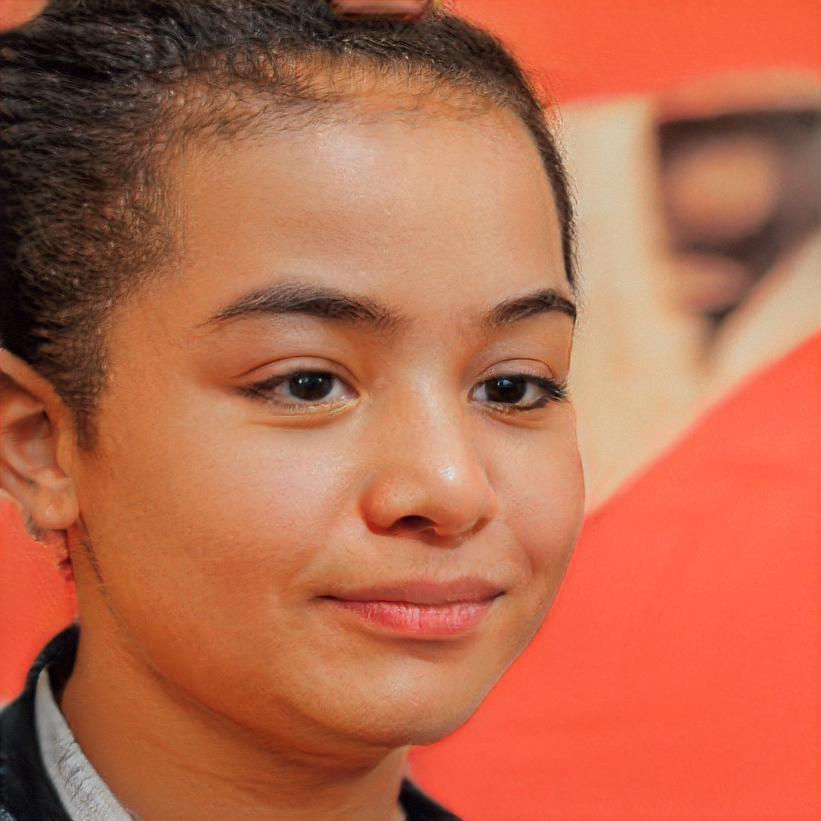
Real vs AI-Generated Photo Challenge
A
B
Notes:
Image A is real.
Clue: In photo B, the eyes aren’t lined up well, the skin looks too smooth, the background is blurry, and the ear and hair have strange details.

Slide 29


Real vs AI-Generated Photo Challenge
A
B
Notes:
Image B is real.
Clue: In photo A, the glasses look a bit weird and don’t fit the face properly, the hair has some strange blurry parts and shiny spots that don’t look real, and the background looks blurry and messy.

Slide 30
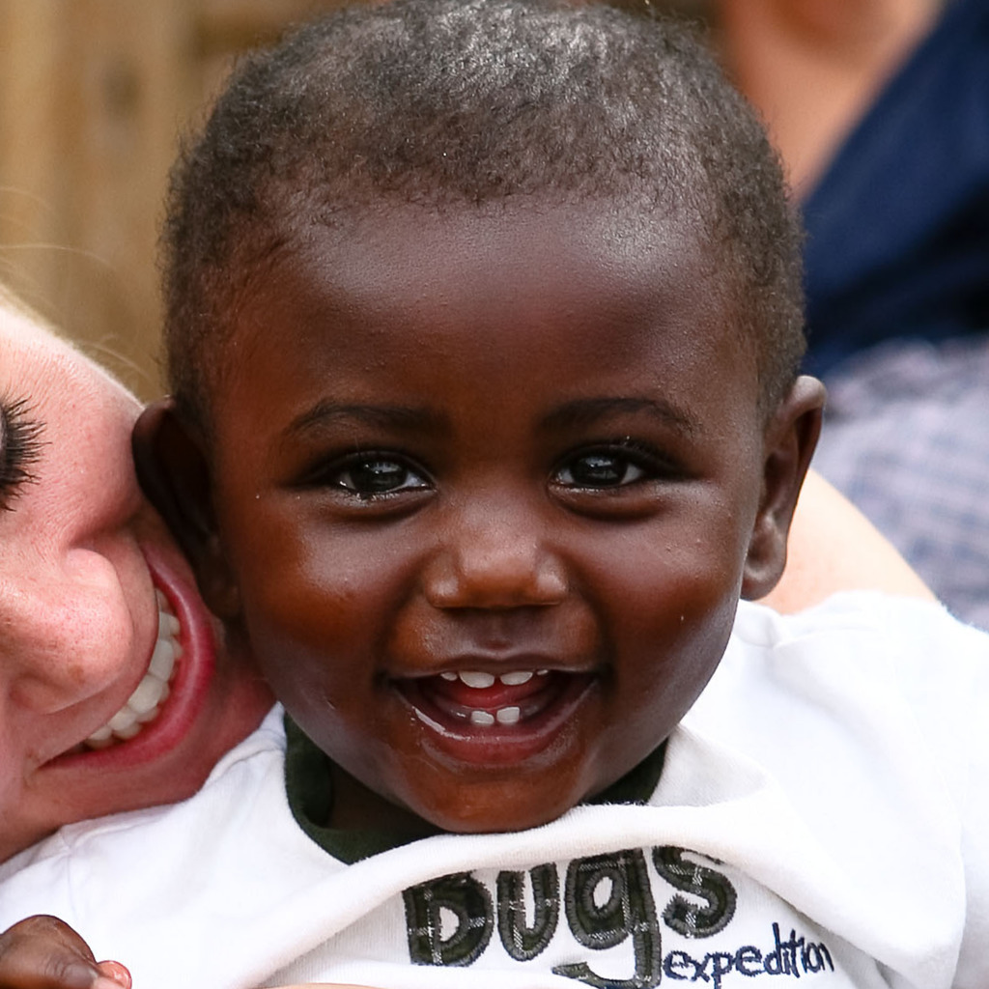

Real vs AI-Generated Photo Challenge
A
B
Notes:
Image A is real.
Clue: In photo B, the background looks strangely blurry, especially around the hair and shoulders, which seem to blend into it in a weird way. Also, the lighting on the face doesn’t match the rest of the picture.

Slide 31

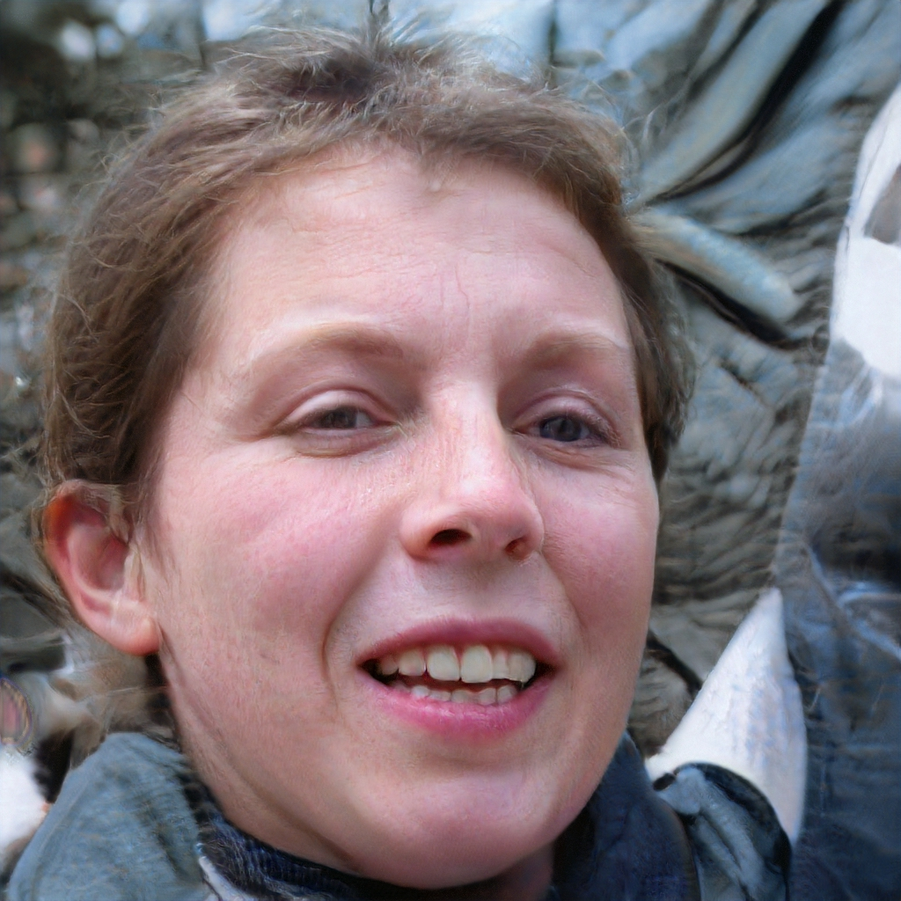
Real vs AI-Generated Photo Challenge
A
B
Notes:
Image A is real.
Clue: In photo B, the background is weirdly blurry, and the hair and shoulders look like they’re melting into it. The light on the face also doesn’t match the rest of the picture.

Slide 32
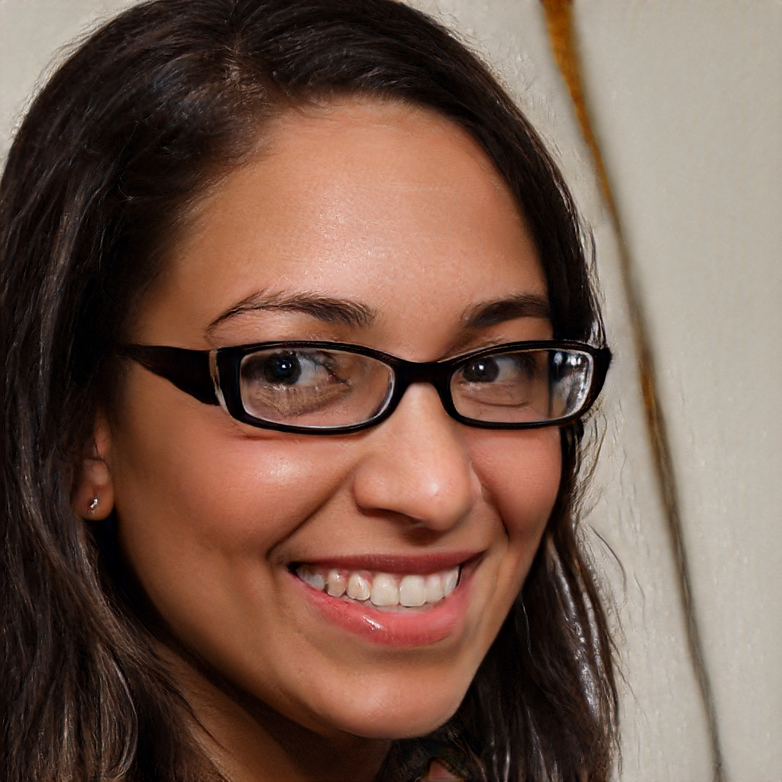
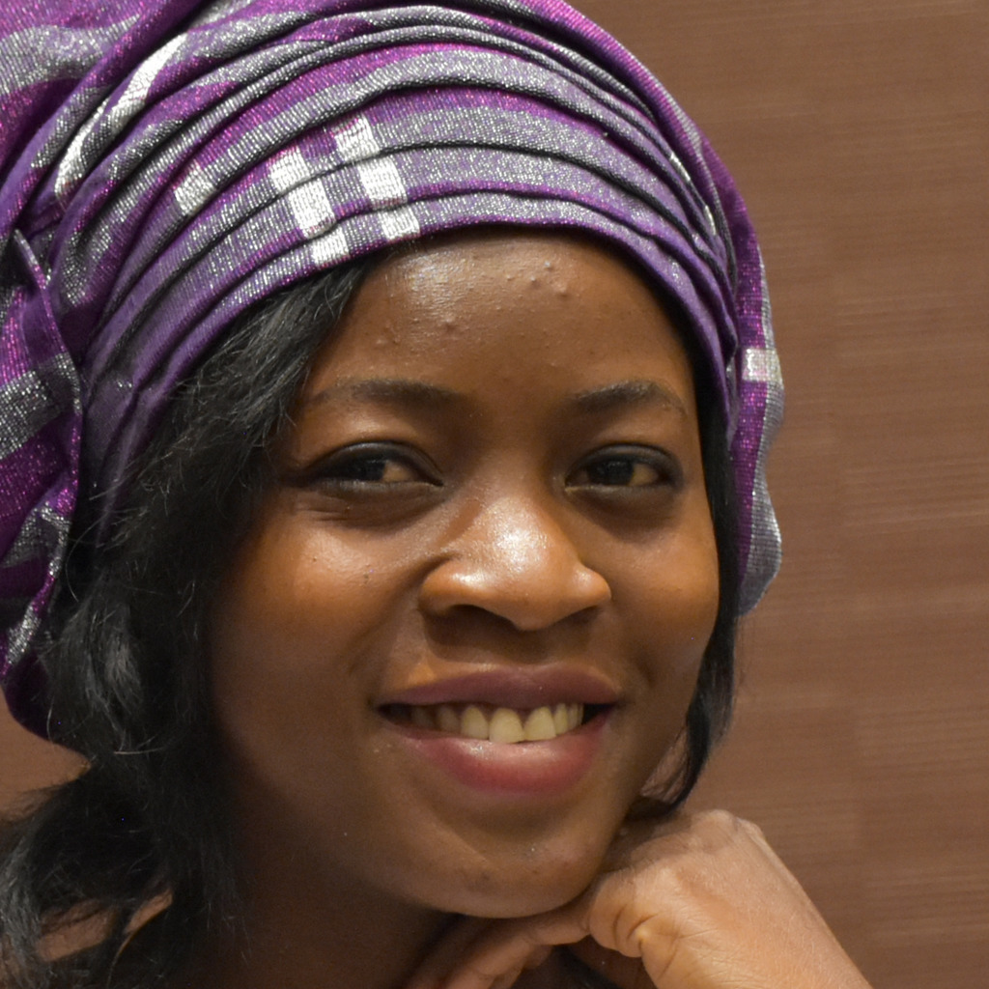
Real vs AI-Generated Photo Challenge
A
B
Notes:
Image B is real.
Clue: In photo A, the glasses look a bit strange and don’t sit naturally on the face, the background has weird lines and shapes that don’t make sense, and the hair looks too smooth or blurry in some spots.

Slide 33


Continue Learning
TikTok: Rumors, Misinformation and Conspiracy Theories on Your #FYP
Exploring the YouTube Algorithm
Notes:
Notes for Facilitators:
If you have more time or multiple sessions with learners, consider taking them through these two presentations. For additional related training materials, please visit: https://www.cip.uw.edu/misinfoday-library

